Slide 1




Unblinding Request: Unfolding the Atmospheric Muon Flux with IceCube Pascal Gutjahr
WG: Dennis
Coll.: Anatoli
Tech: Karolin
wiki page
Analysis Call
December 04, 2025
Source: NASA

Slide 2

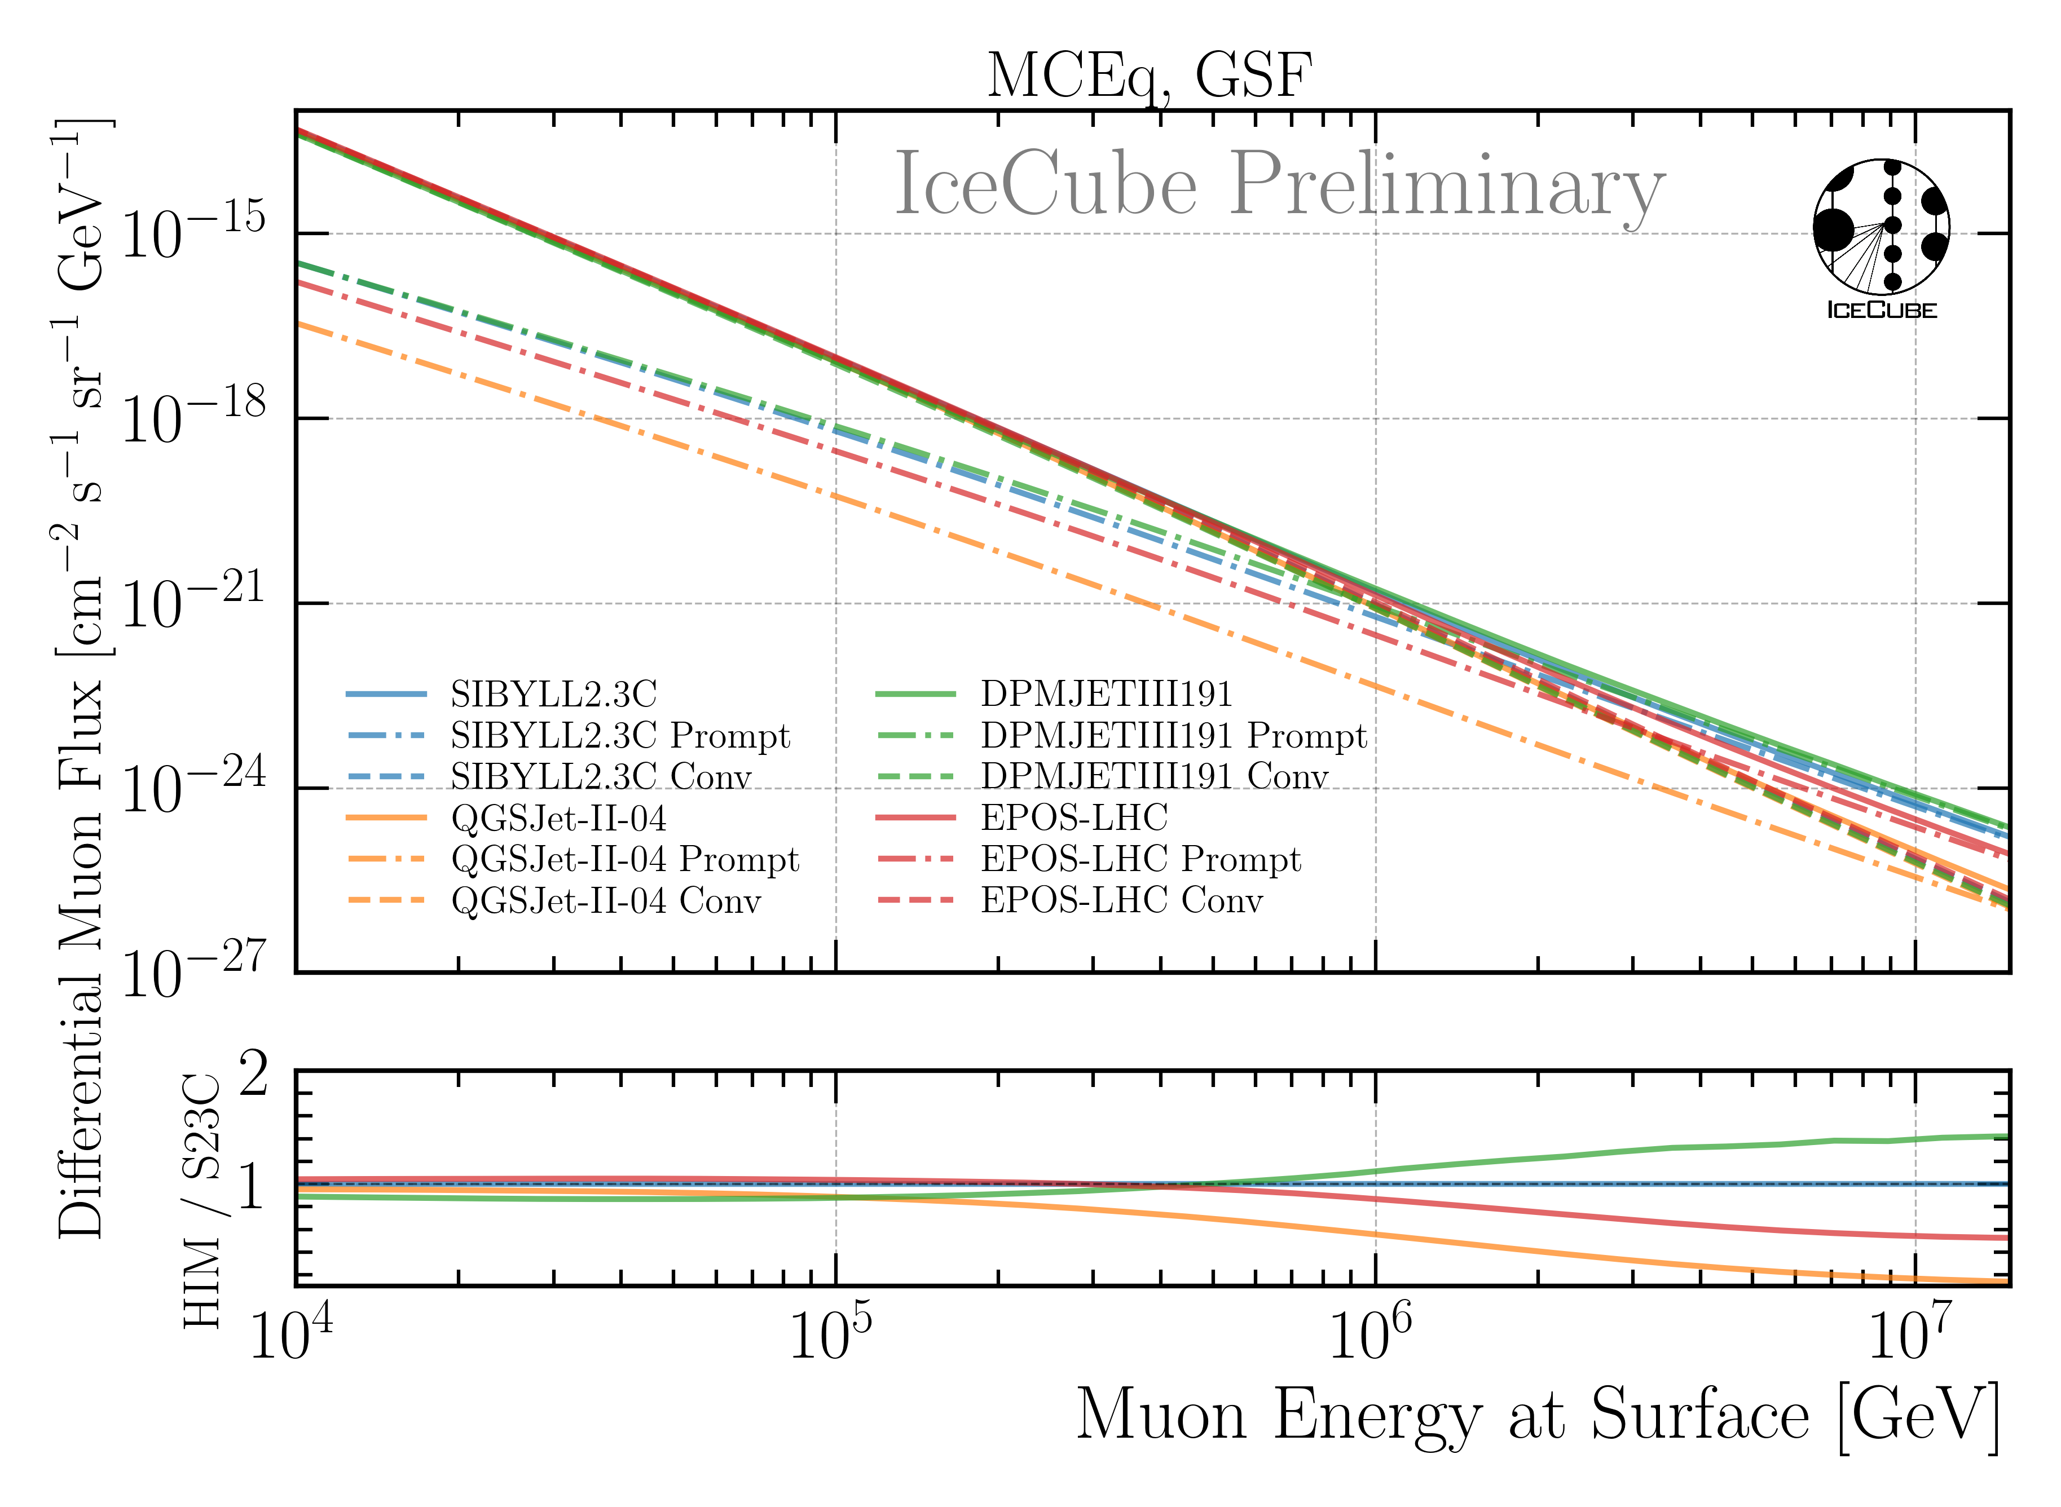
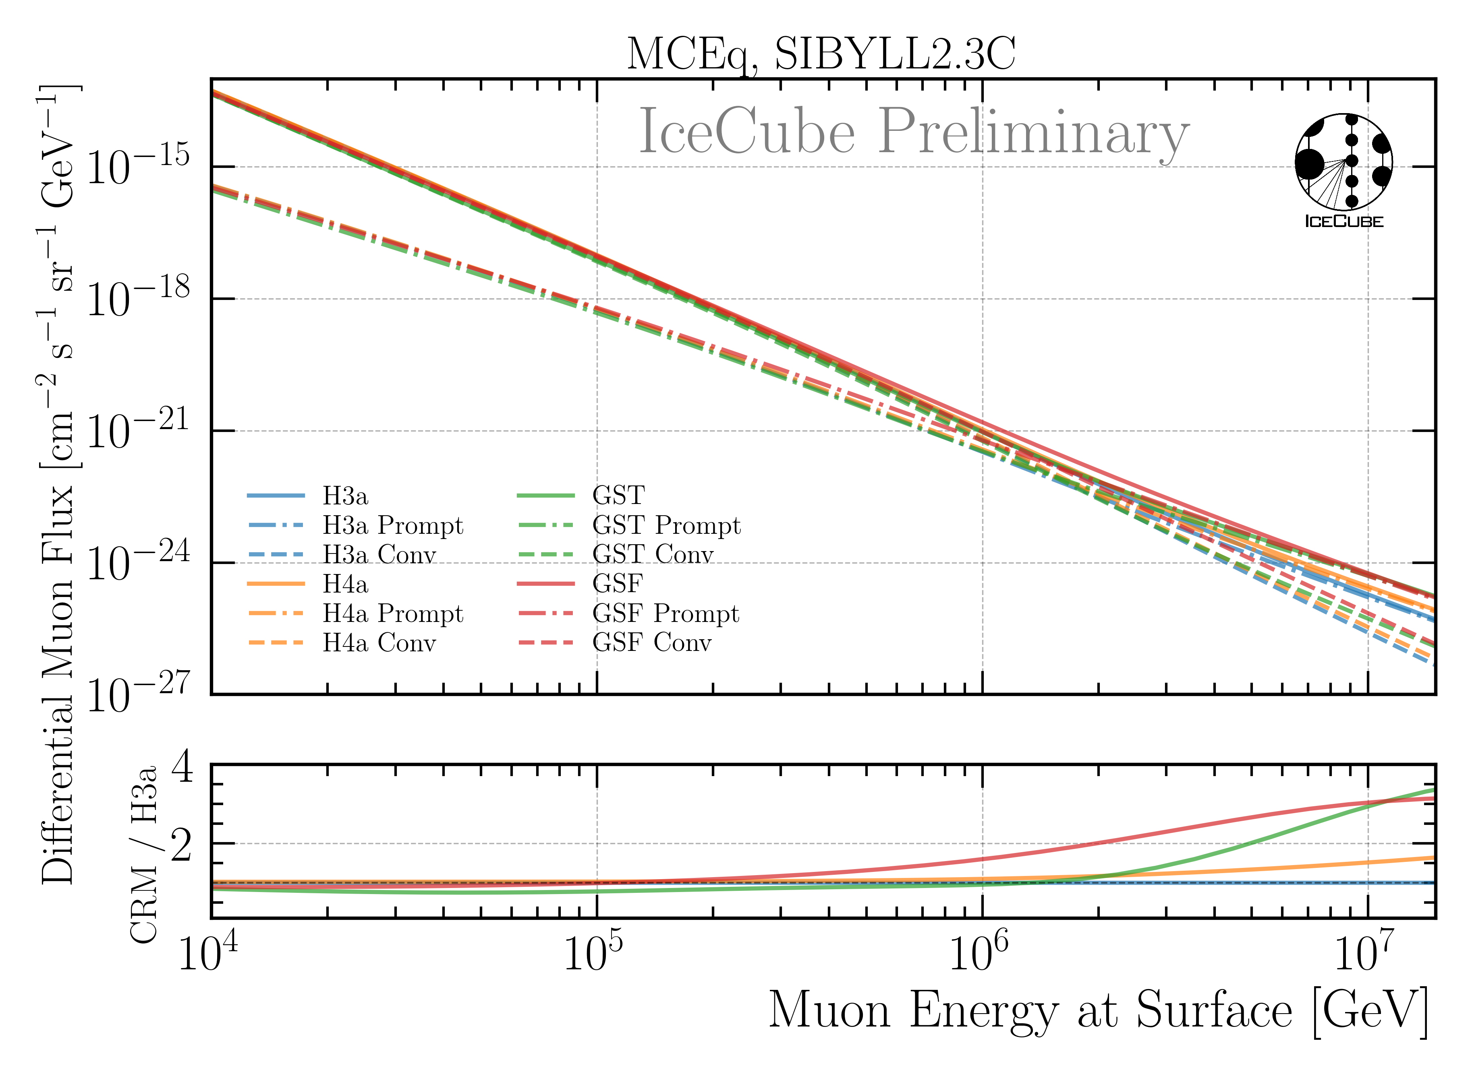
Impact of Hadronic Interaction Models?
+50%
+250%
Only SIBYLL and DPMJET include charm
Constant offset < 100 TeV → irrelevant for unfolding
Up to 50% difference at highest energies
Difference between primary models about 250%
Unfolding recovers this spectral index change within uncertainties

Slide 3
Combine CORSIKA Sets
22774—8 (my dataset)
23530—1 (additional high energetic events)
23111 (Lucas dataset)
20904 (Standard CORSIKA)

Slide 4
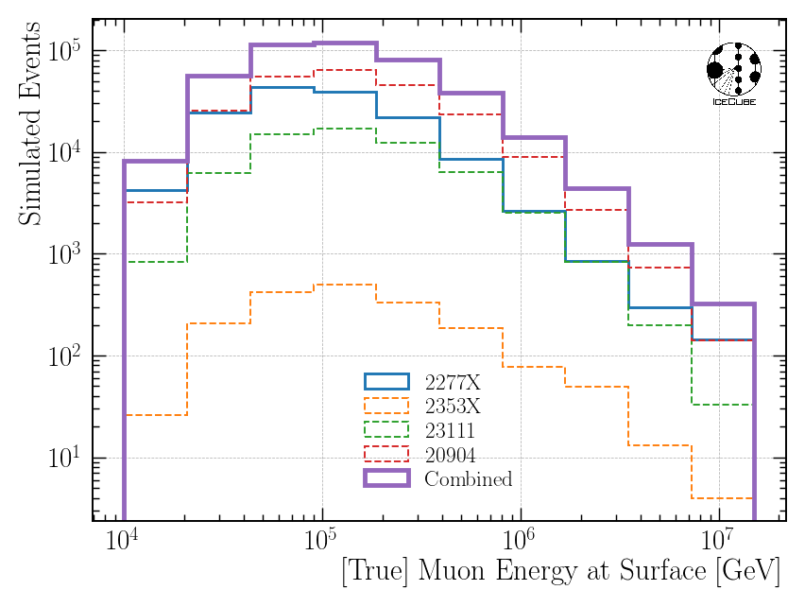
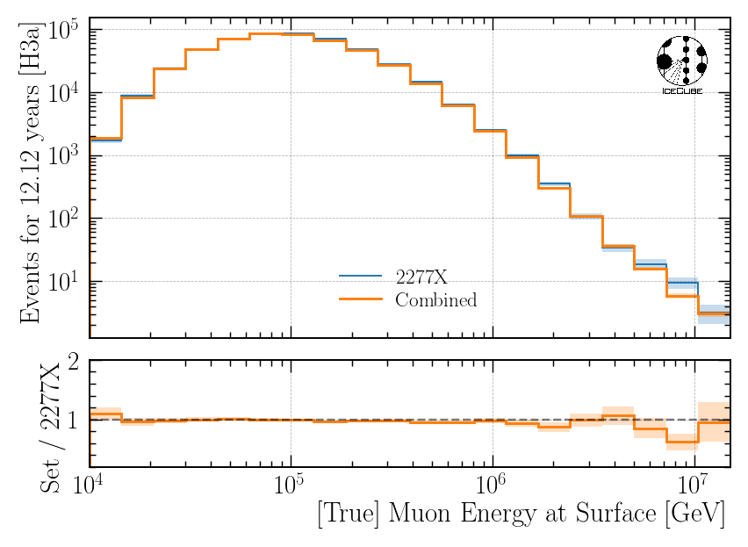
Combine Several CORSIKA Datasets
simulated
weighted
Before: Only 2277X
After: All sets → better statistics
Weighting works

Slide 5
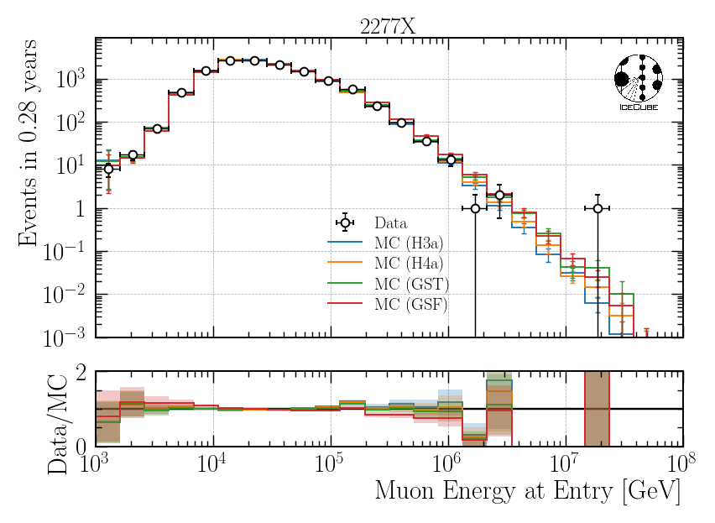
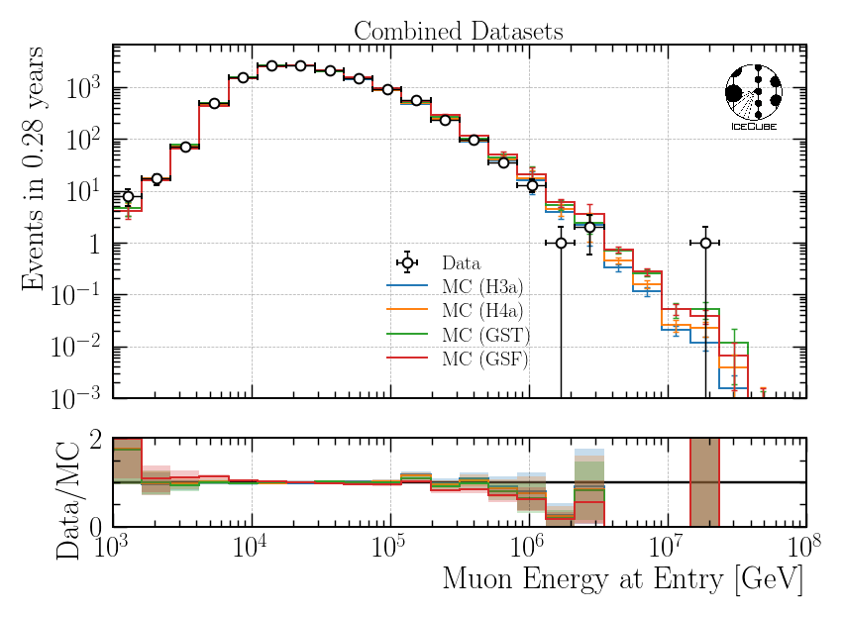
Check Data-MC on Burnsample
Single Dataset
Combined Dataset
Same agreement between 2277X and combined datasets

Slide 6
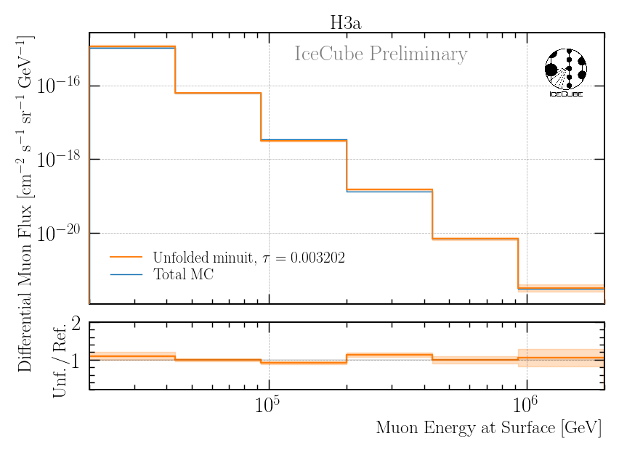
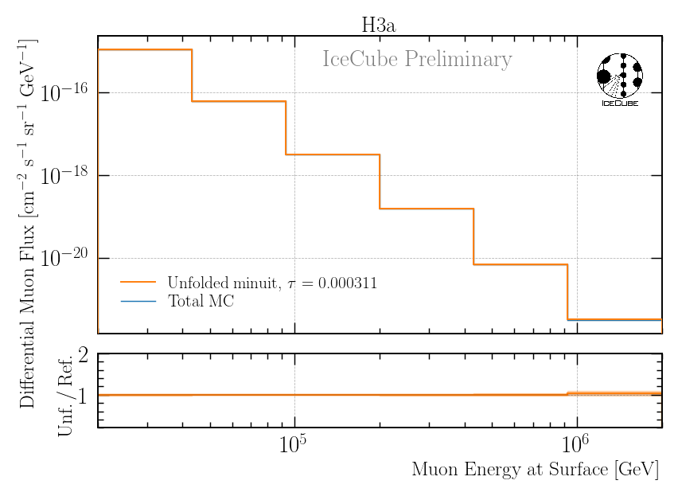
Compare Burnsample Unfolding Bias
Single Dataset
Combined Dataset

Slide 7
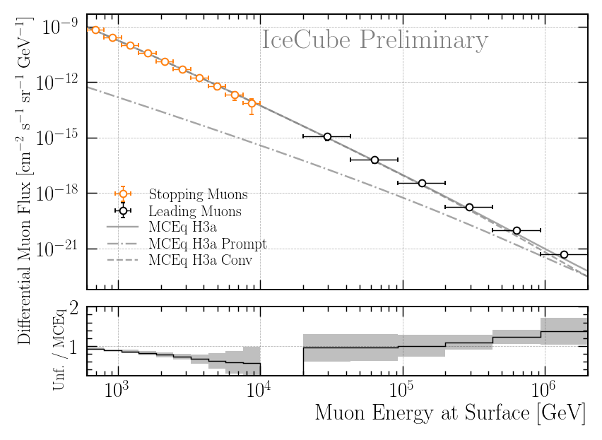
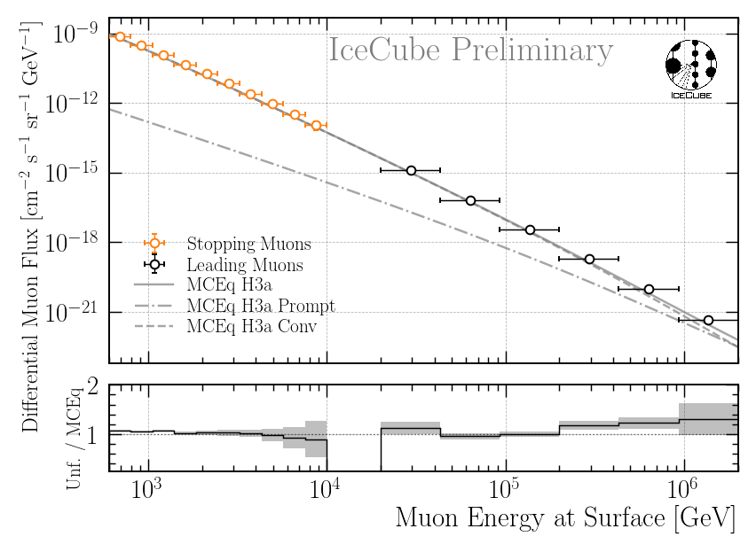
Compare Burnsample Unfolding
Stopping muon unfolding has improved since ICRC
→ Unblinding request soon
*result from ICRC
*4 unfoldings average
Single Dataset
Combined Dataset
Same result for 2277X unfolding and combined unfolding

Slide 8
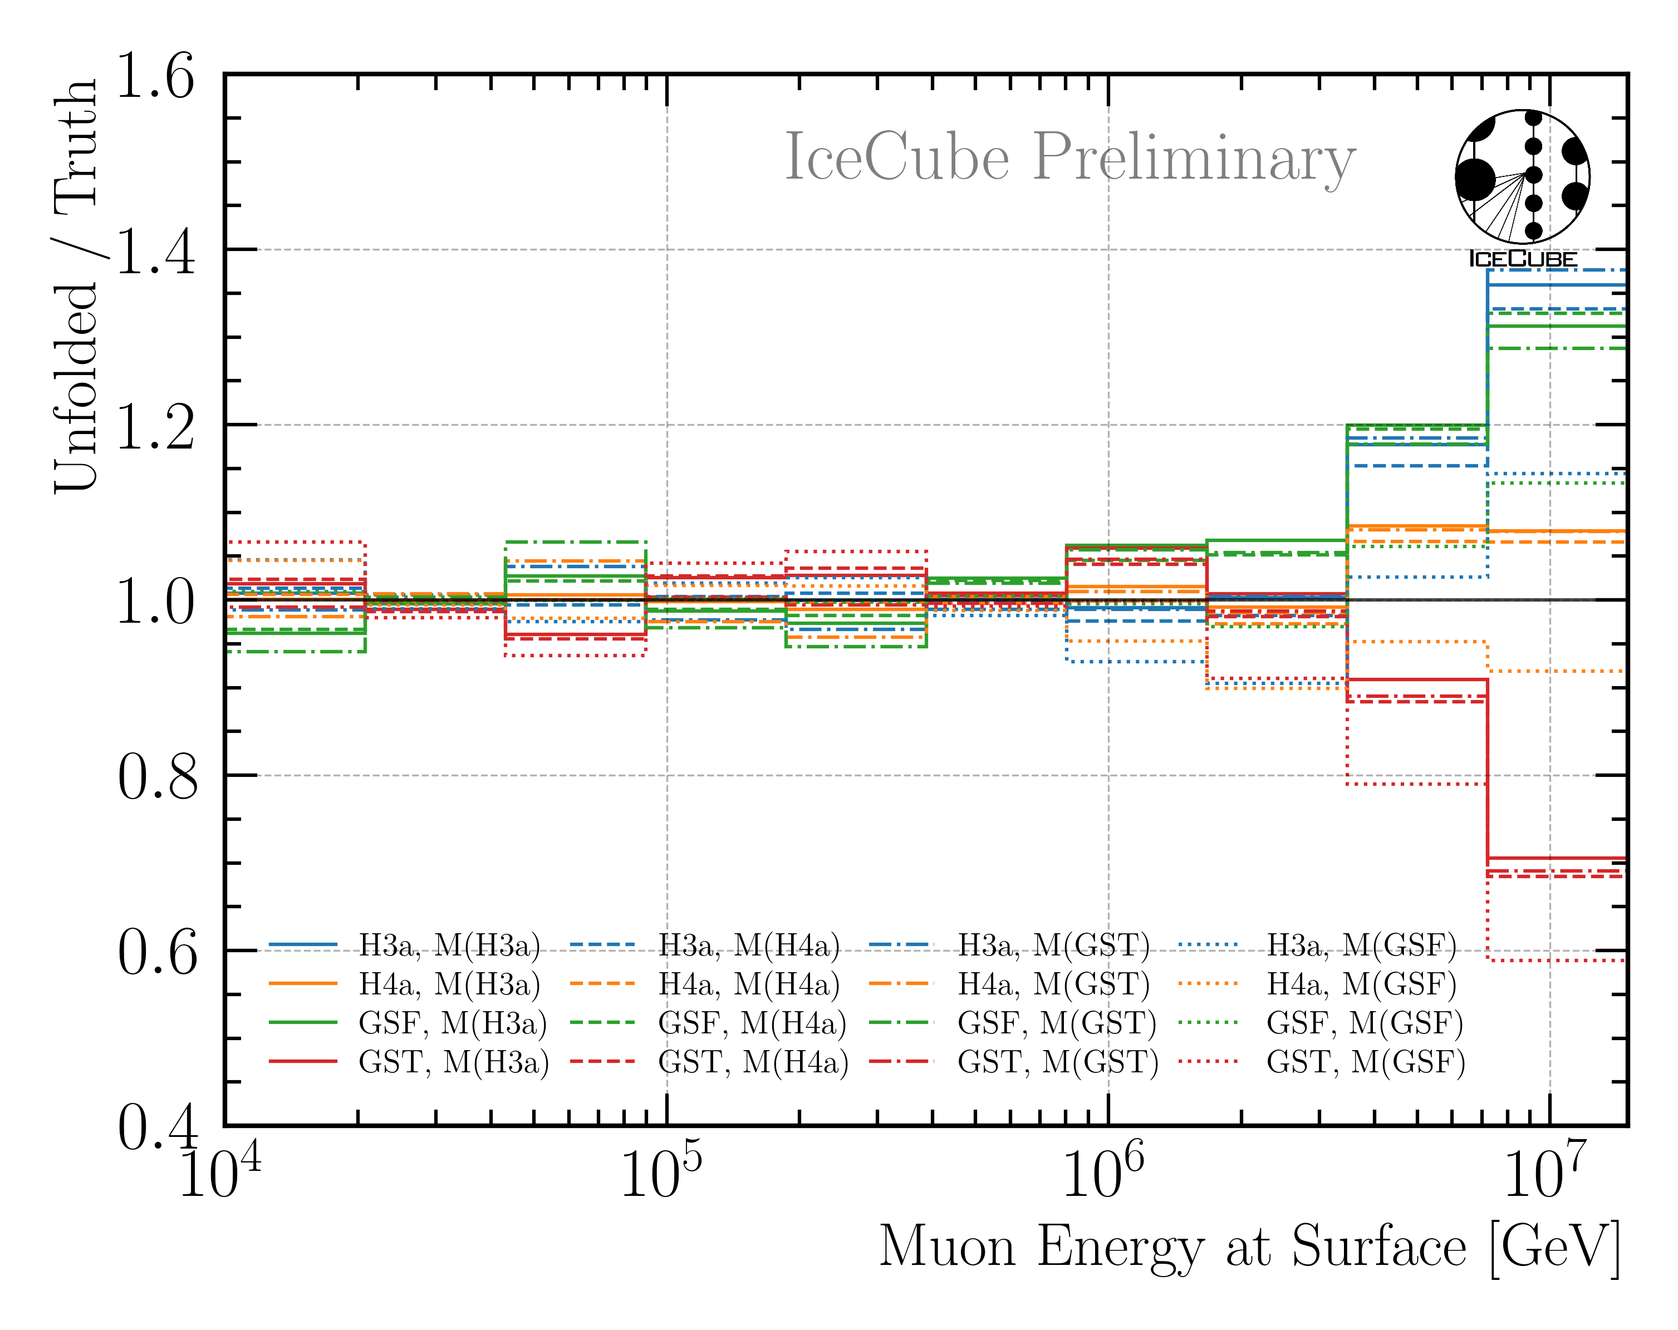
Compare “Unfolding Bias”
Single Dataset
Combined Dataset
Combining datasets improves injection recovery

Slide 9
Summary
HIM impact: smaller than primary model impact
Specific simulations take too many resources → not feasible
Combine multiple CORSIKA datasets
Better statistics
Same data—MC agreement
Better injection recovery
Burnsample unfolding compatible with ICRC result
Use combined datasets for unfolding
Post unblinding: include stopping muon result in normalization fit to pinpoint conventional component
Stopping muons unblinding request will start in December?!

Slide 10
Backup

Slide 11
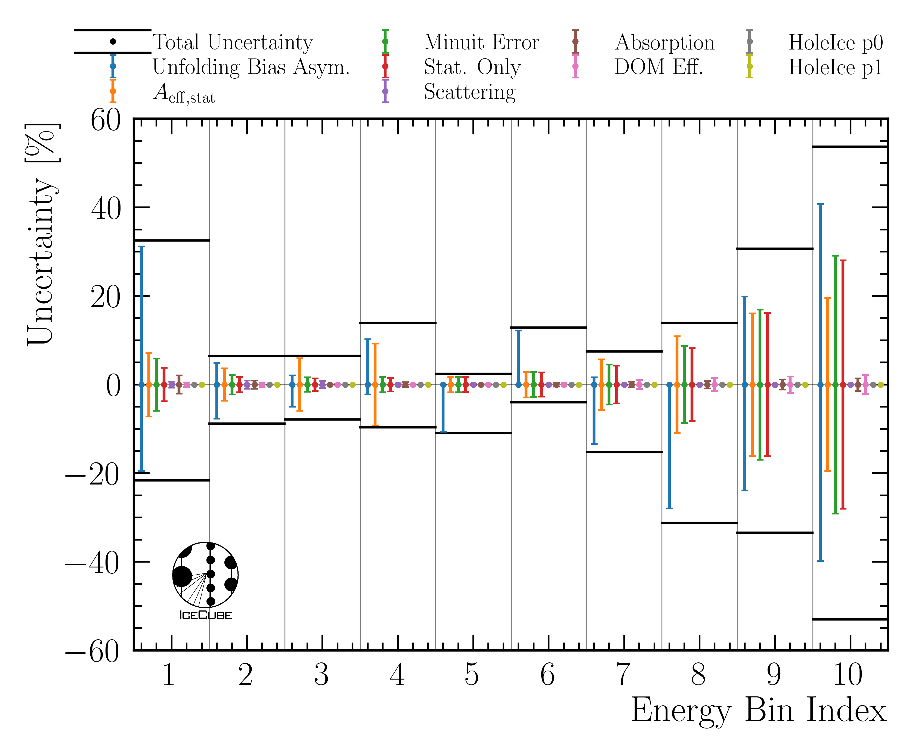
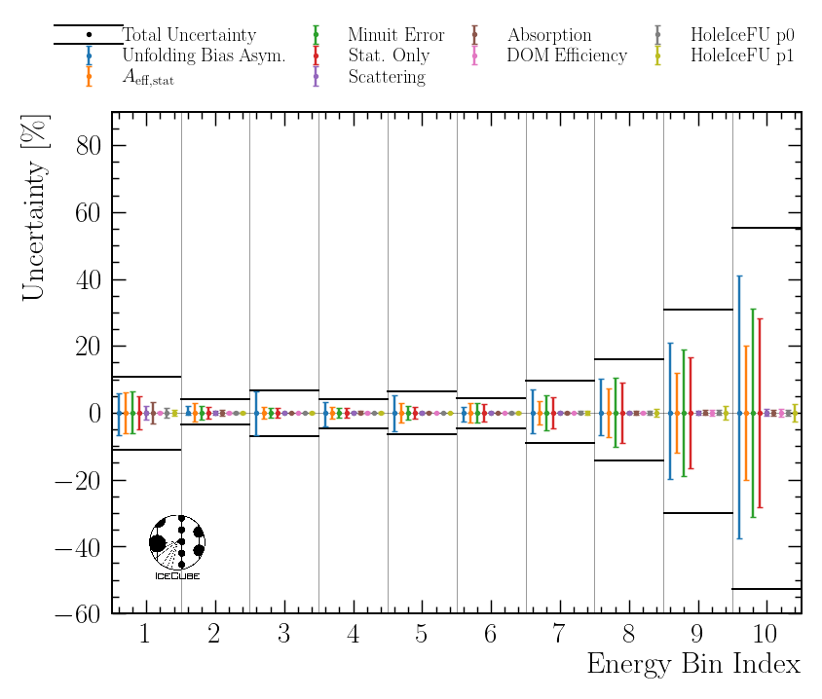
Comparison Uncertainties per Bin
Single Dataset
Combined Dataset

Slide 12
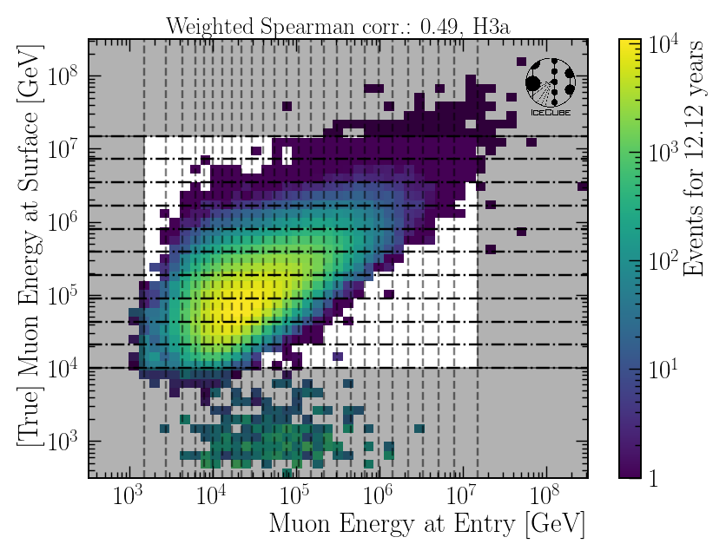
Target – Pseudo Correlation
shaded area indicates analysis binning
coincident primary events, as expected below 10 TeV

Slide 13
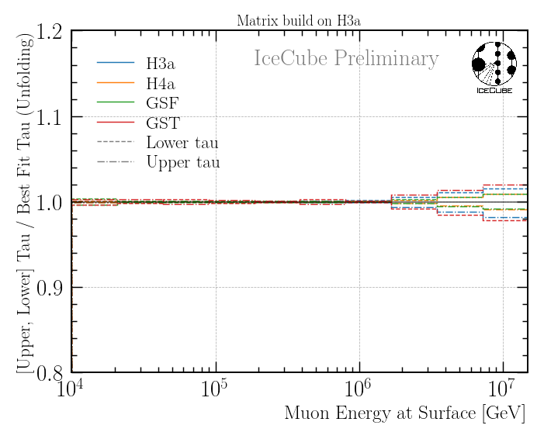
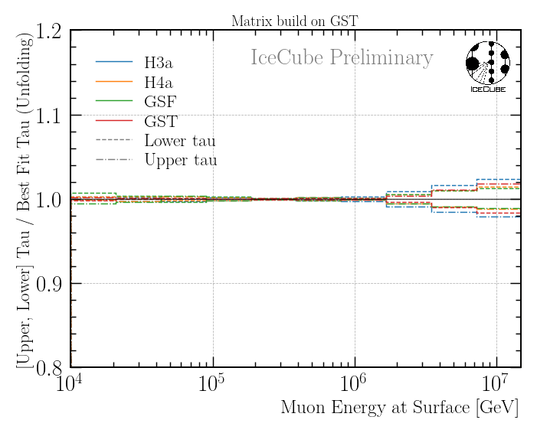
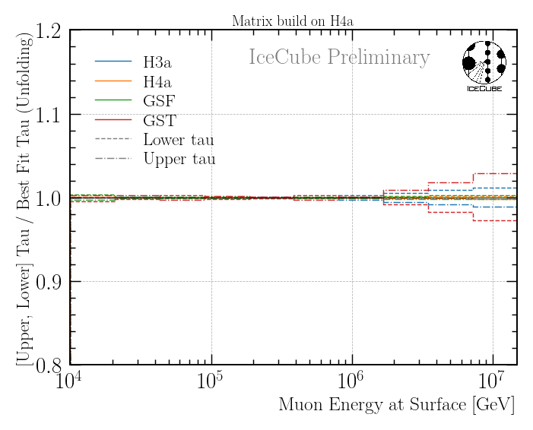
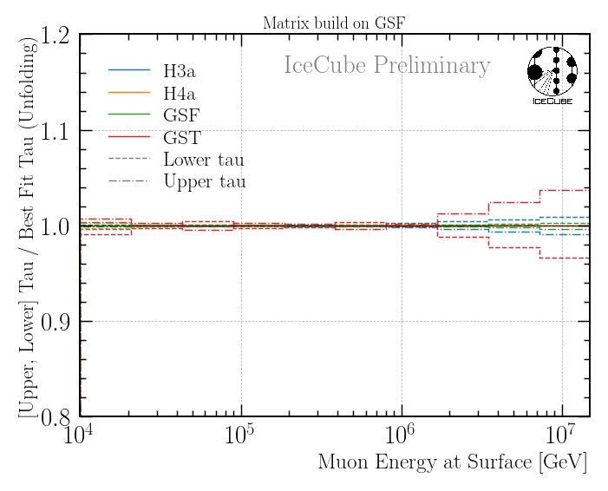
Regularization Impact
regularization impact below 5%

Slide 14
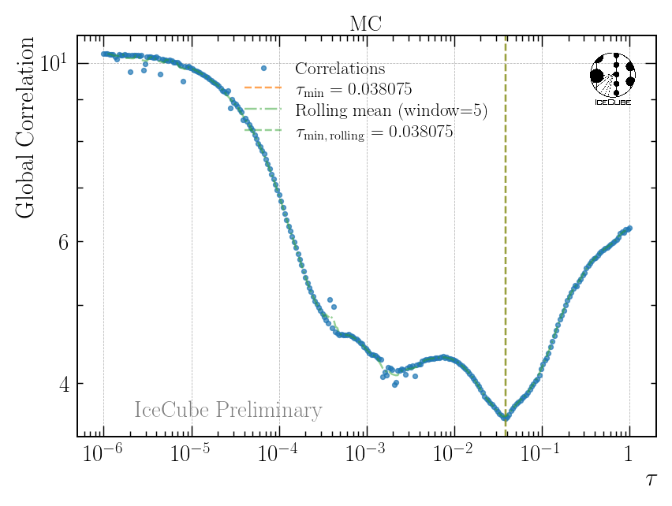
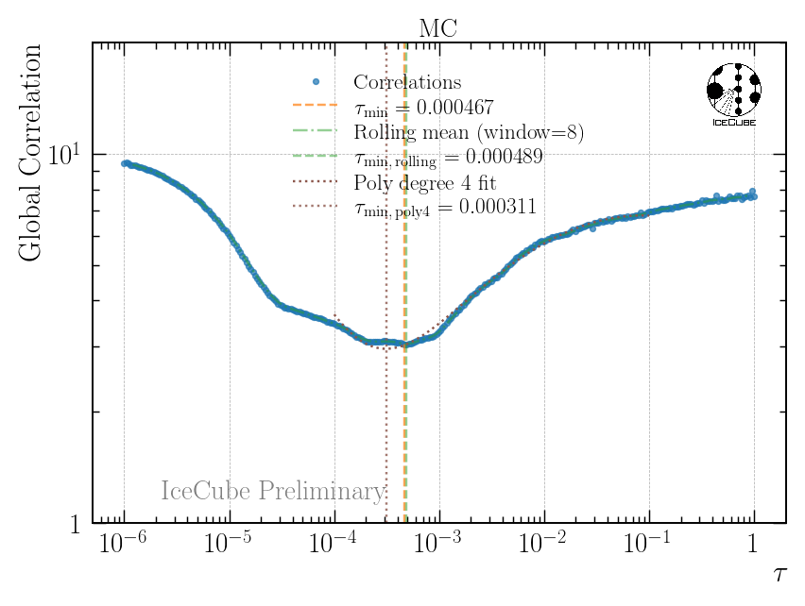
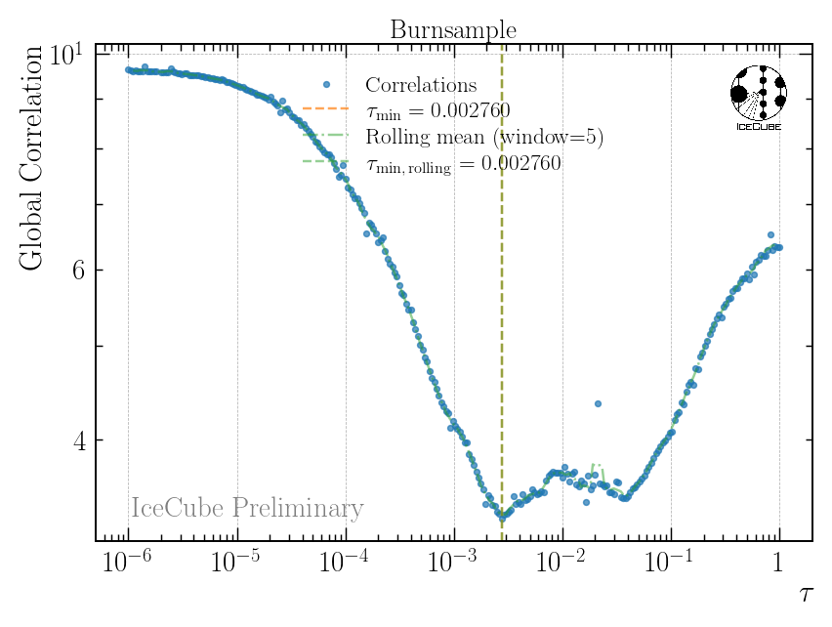
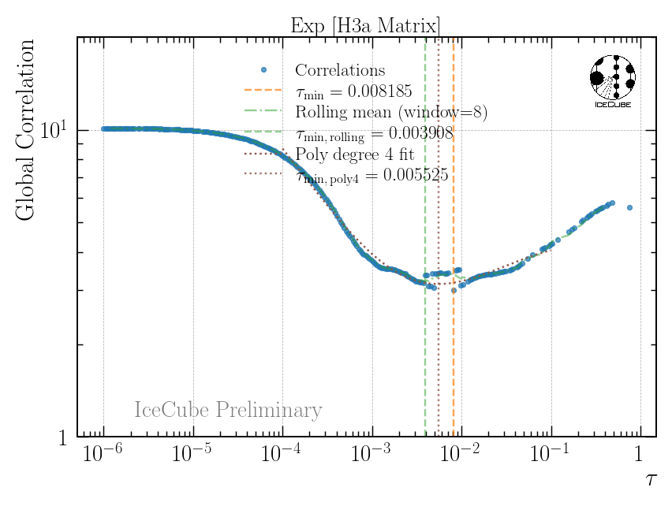
Compare Burnsample Unfolding Global Correlation
MC
Burnsample
Single Dataset
Combined Dataset

Slide 15
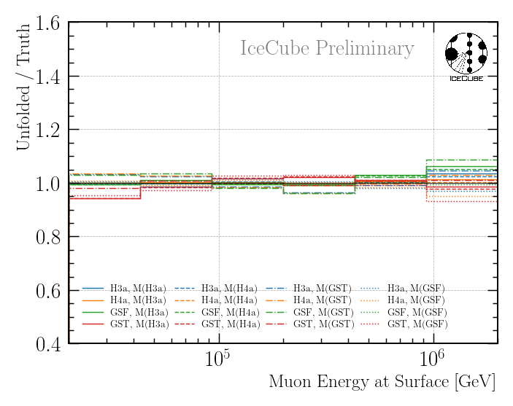
Unfolding Bias on Burnsample with Combined Datasets

Slide 16
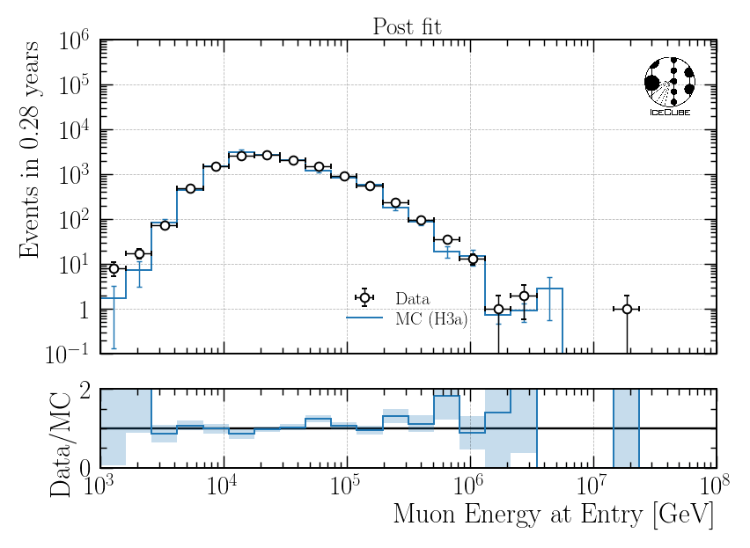
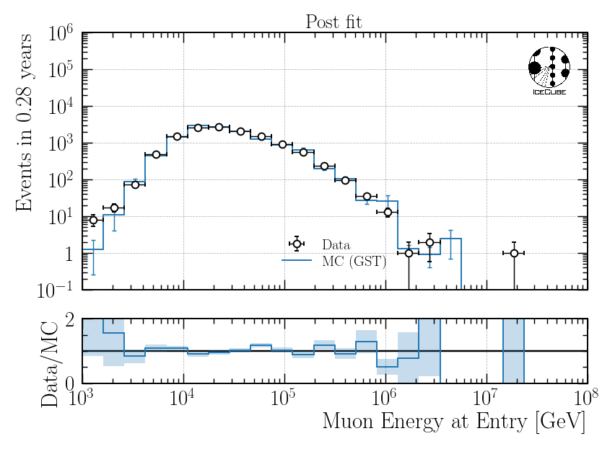
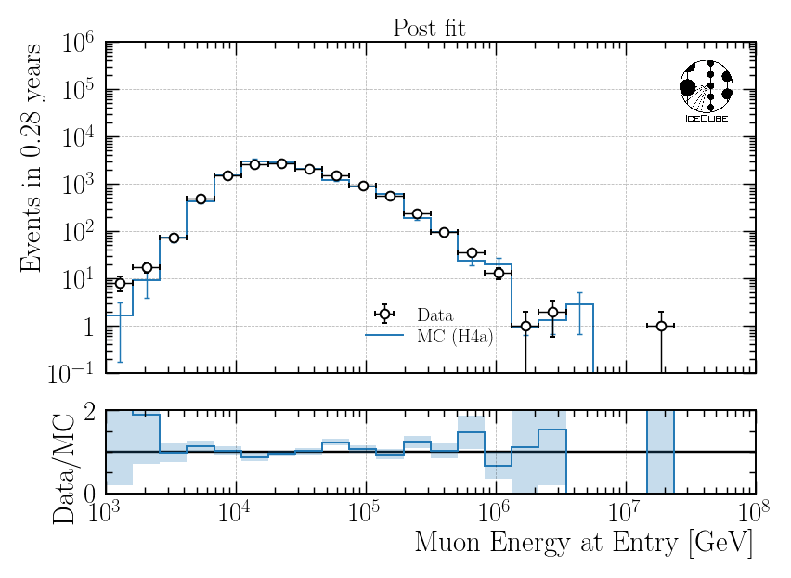
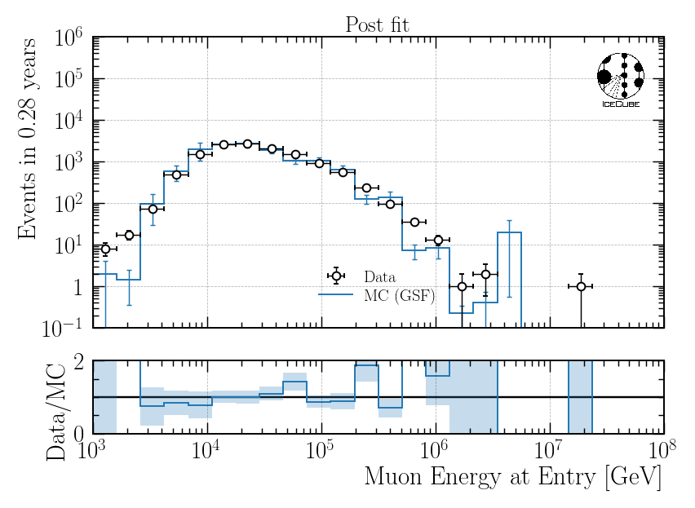
Data-MC Post Fit for 4 Burnsample Unfoldings with Combined Datasets

Slide 17
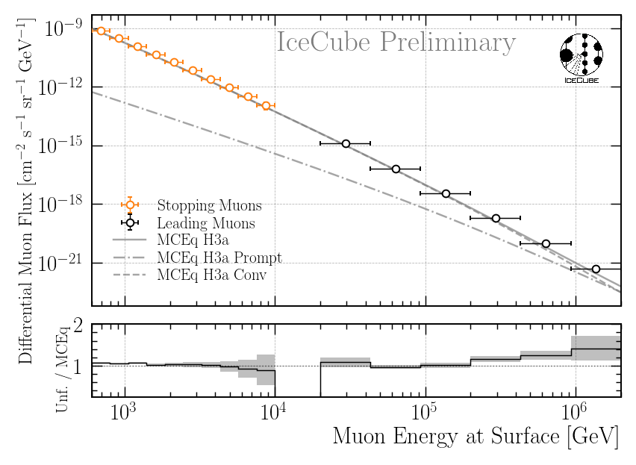
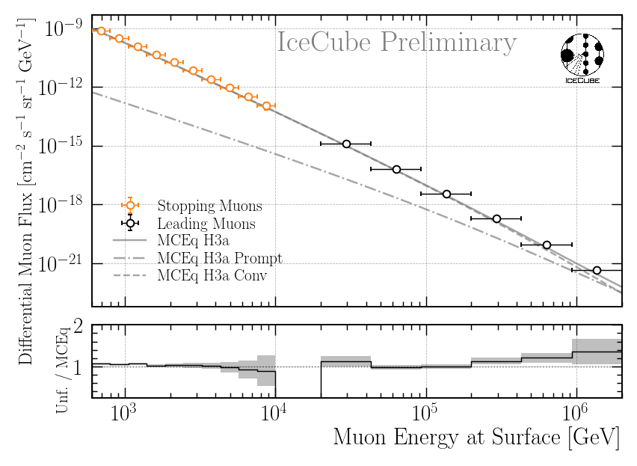

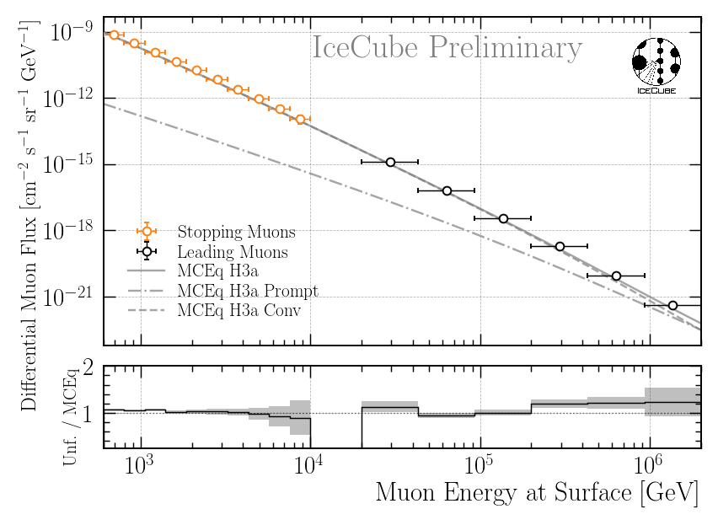
4 Burnsample Unfolding Results with Combined Datasets
H3a Matrix
GST Matrix
H4a Matrix
GSF Matrix

Slide 18
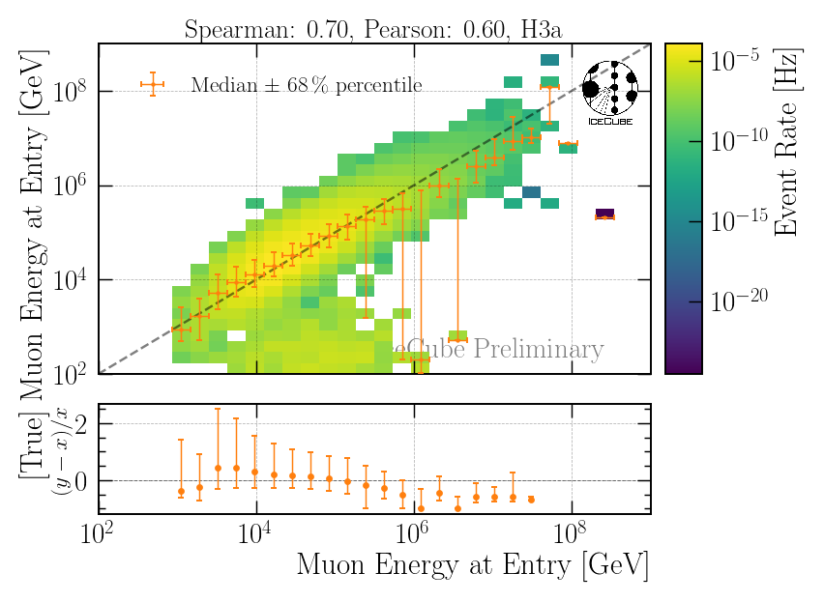
Reconstruction Performance on Combined Dataset
all events
coincident primary events

Slide 19
Cosmic Ray Air Shower – Muon Flux
Measure muon flux at surface
Characterize prompt and conventional component
prompt
conventional
Conventional Muon:
Parent is pion or kaon
Prompt Muon:
„Rest“

Slide 20
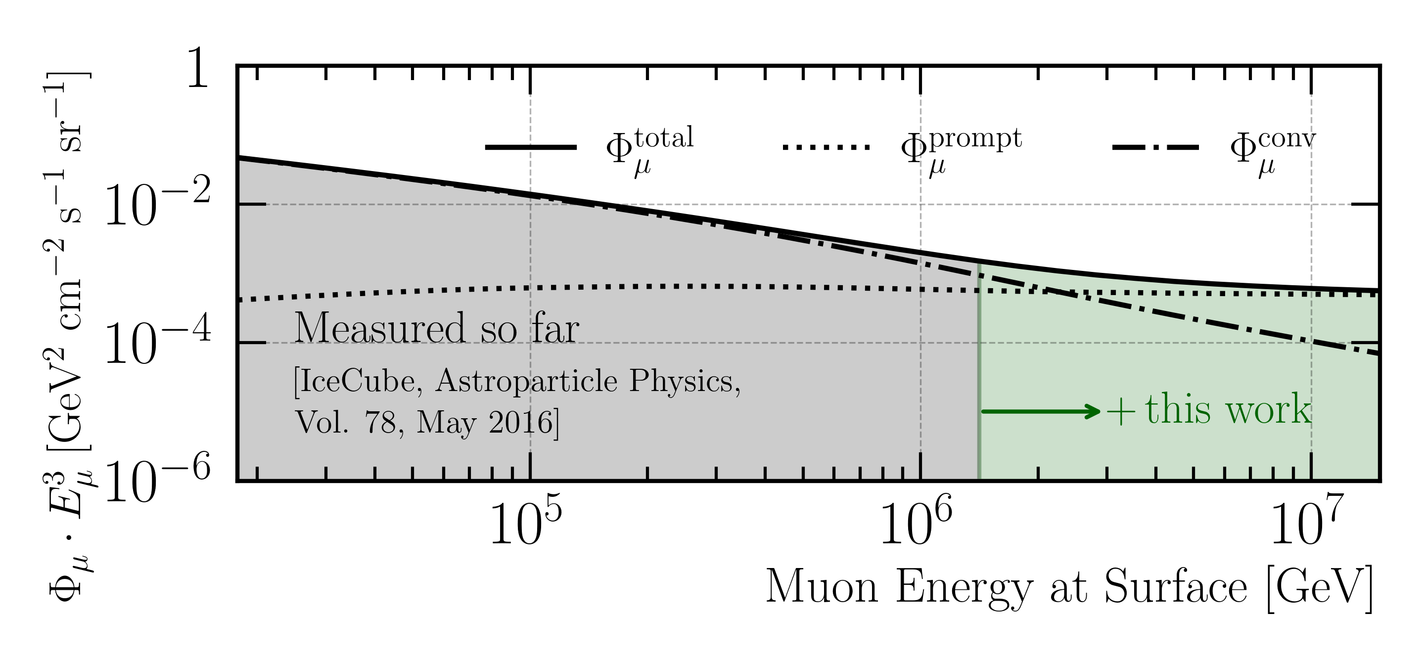
Goal: Measure Muon Flux at Surface
MCEq: SIBYLL 2.3d (H3a)

Slide 21
Overview
Simulation
Reconstruction
Selection
Unfolding
Dataset
CORSIKA 77500 Ehist
SIBYLL 2.3d
10 TeV – 100 EeV
Snowstorm
DNN reconstructions
Muon energies
Muon direction
Track geometry
Level 3
L2 muon filter
Add labels
Muon spectrum
Unfold muon flux at surface
Level 4
500 TeV bundle energy cut at surface
Add DNN reconstructions
Validation
Tag prompt / conv particles
MCEq comparisons
Level 5
Data-MC quality cuts
Final Level
Leadingness cut

Slide 22
Simulation

Slide 23
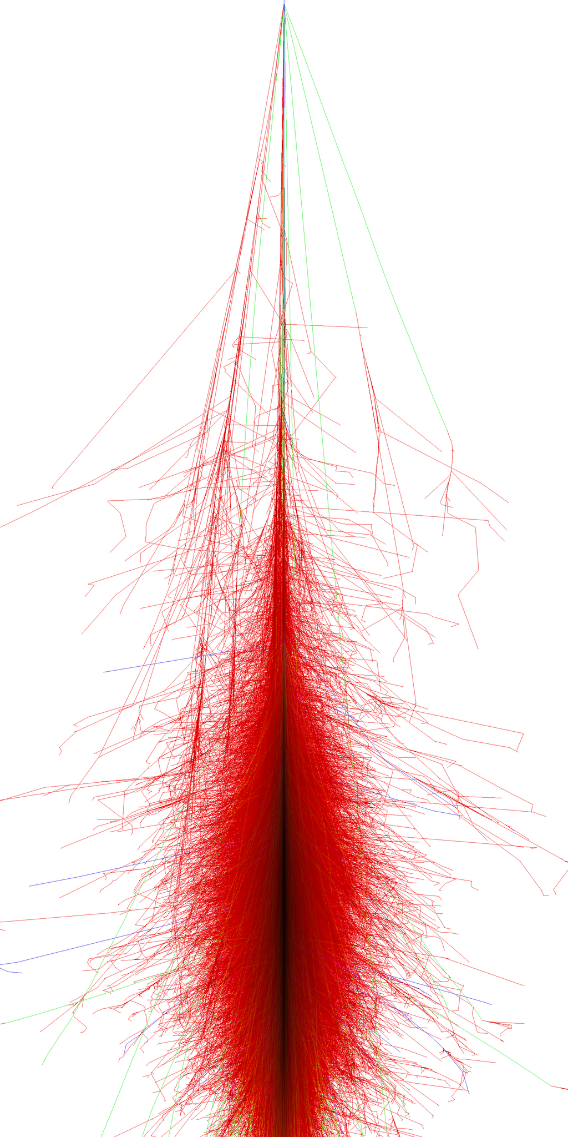
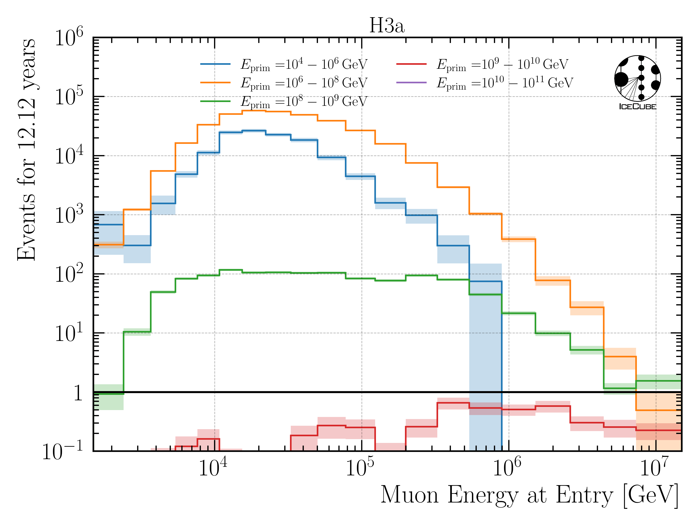
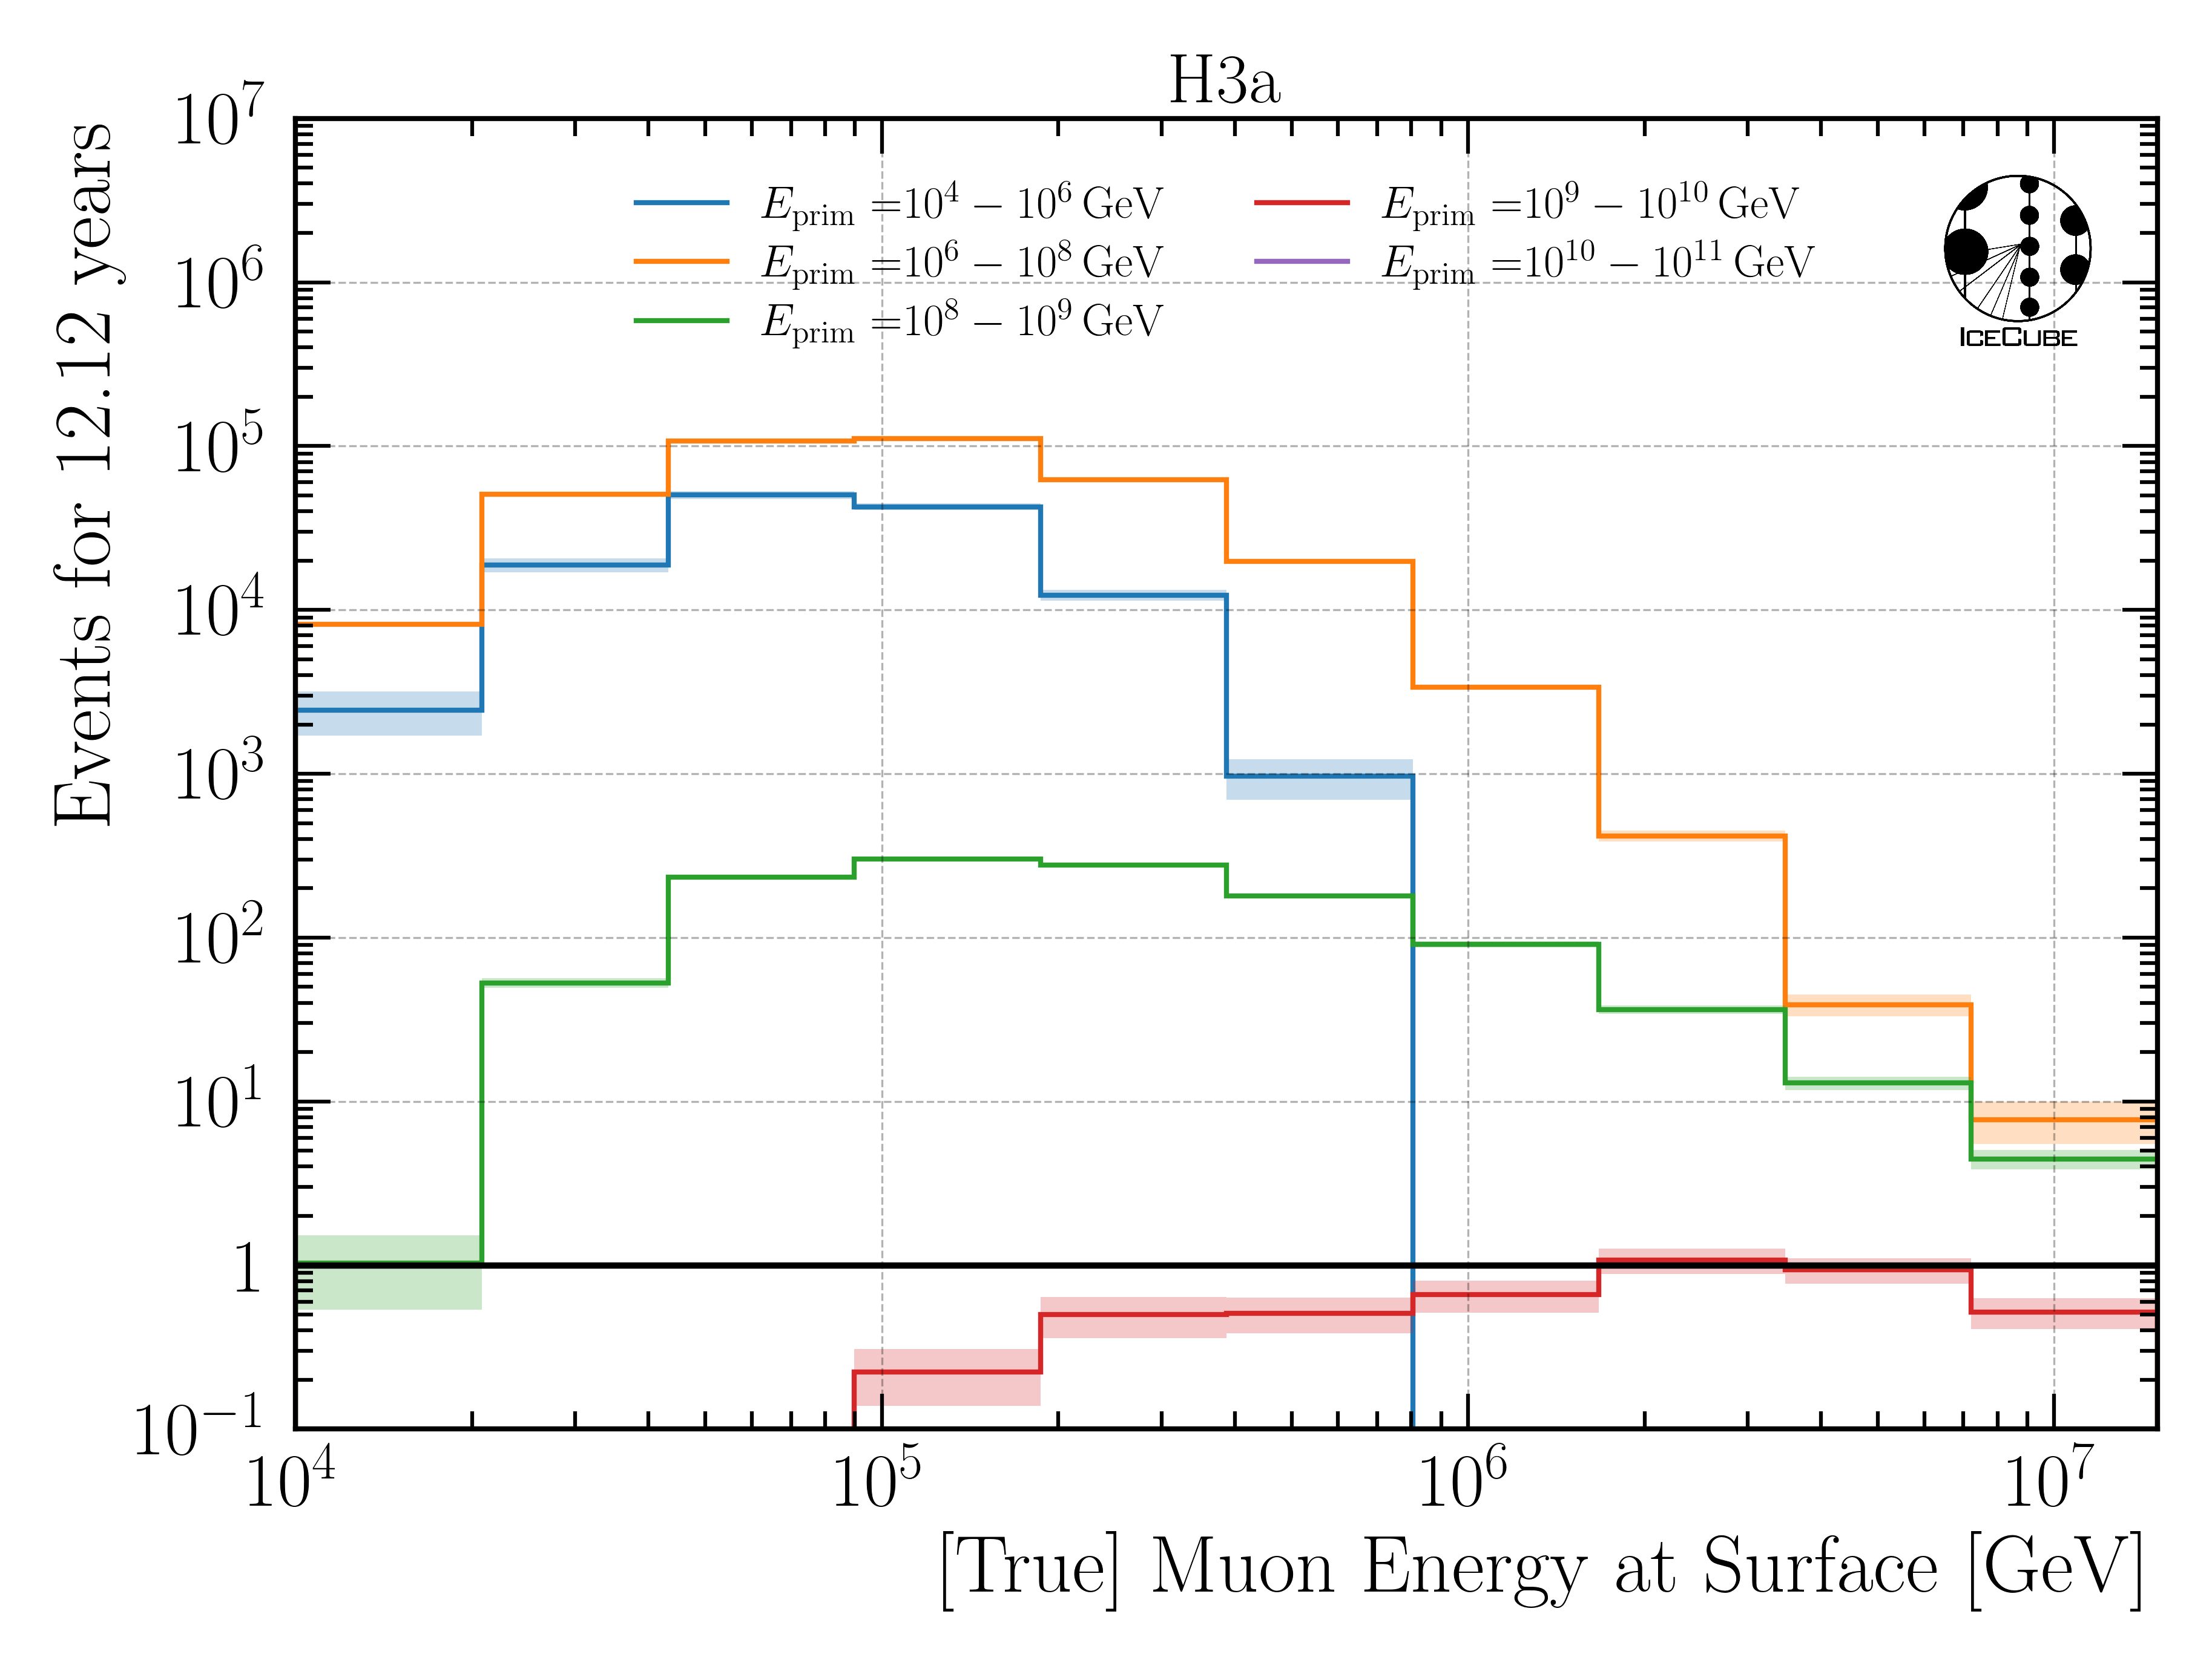
New CORSIKA Simulation
Extended history → get muon parent information
Official iceprod datasets: 22774 – 8
Primary energy: 10 TeV – 1e11 GeV
HIM: SIBYLL 2.3d
Leading muon = most energetic muon in a bundle
Proxy
Target
*22875 is simulated from 600 GeV – 10 TeV, but not used in this analysis
→ from the simulated statistics, no event made it into the final selection stage

Slide 24
Reconstruction

Slide 25
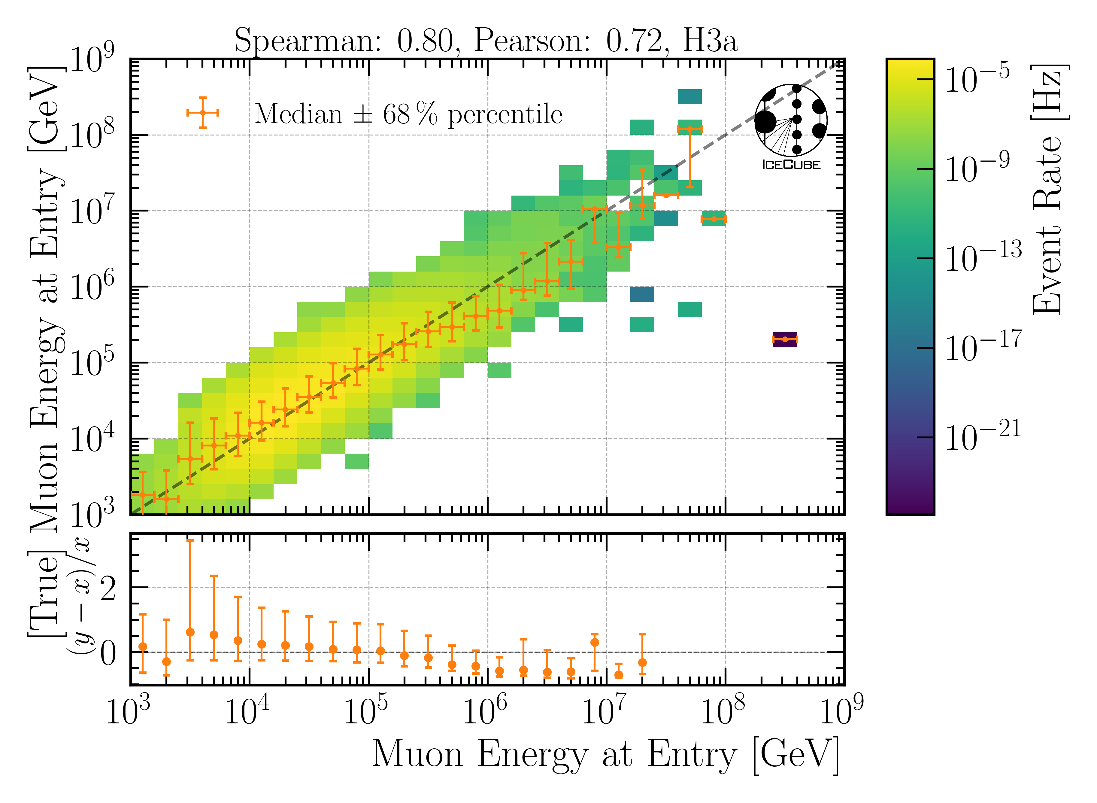
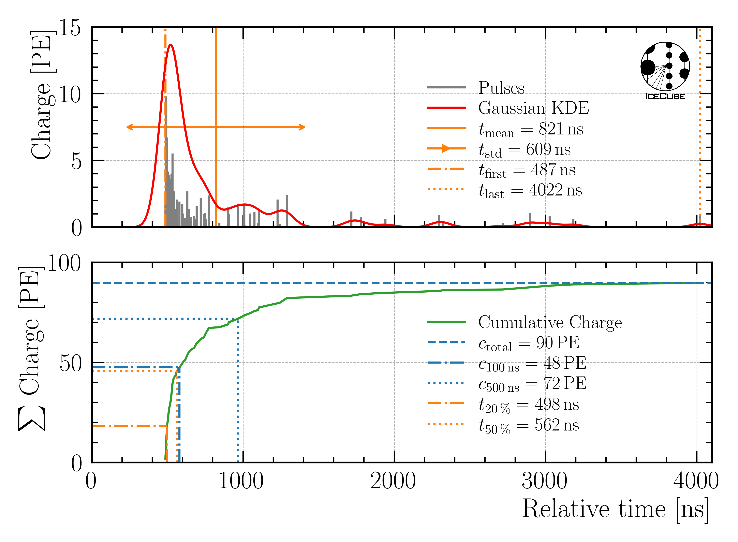
CNN Reconstructions
dnn_reco
Train on multiple CORSIKA datasets
3 / 9 features
SplitInIceDSTPulses
6000ns pulse cleaning
Energies, directions, track geometries
Proxy

Slide 26
Selection

Slide 27
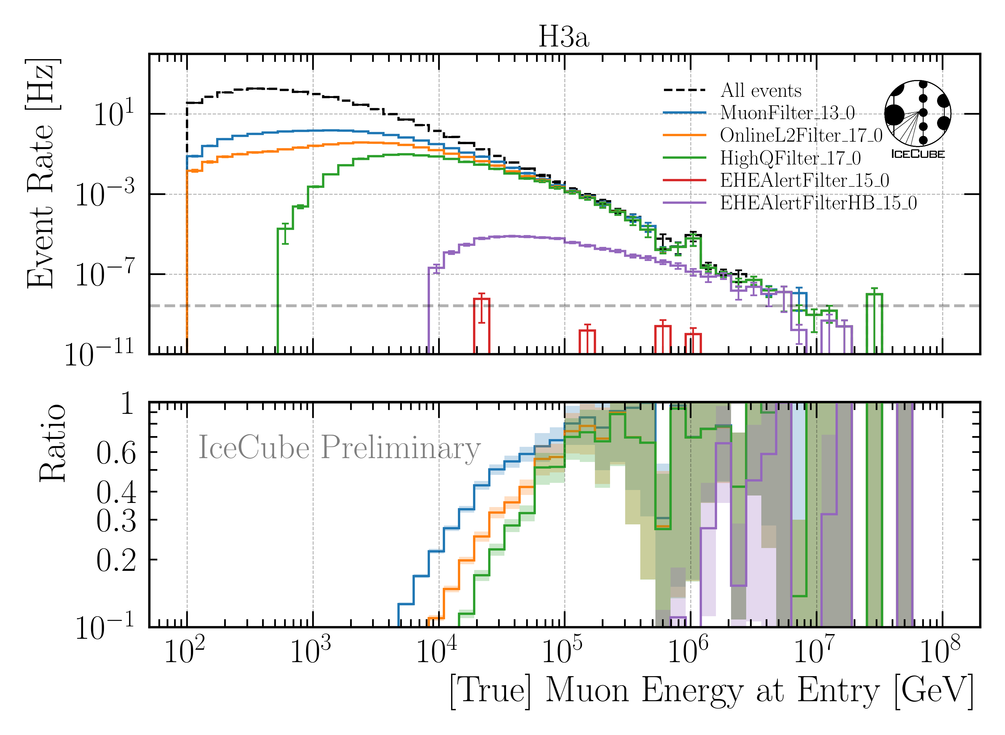
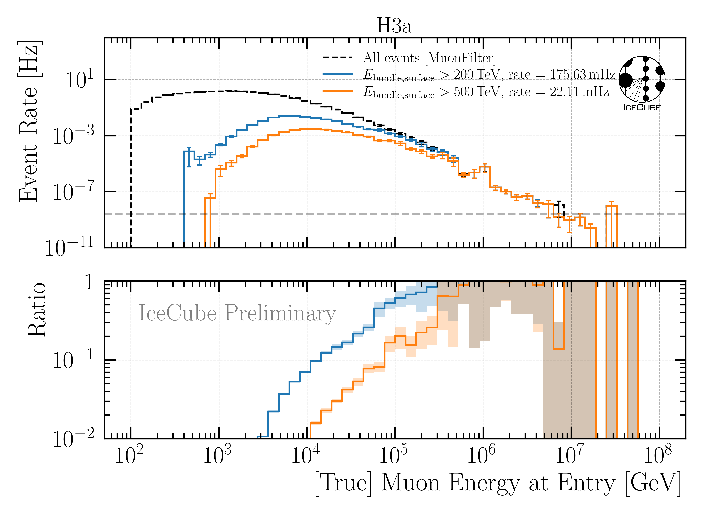
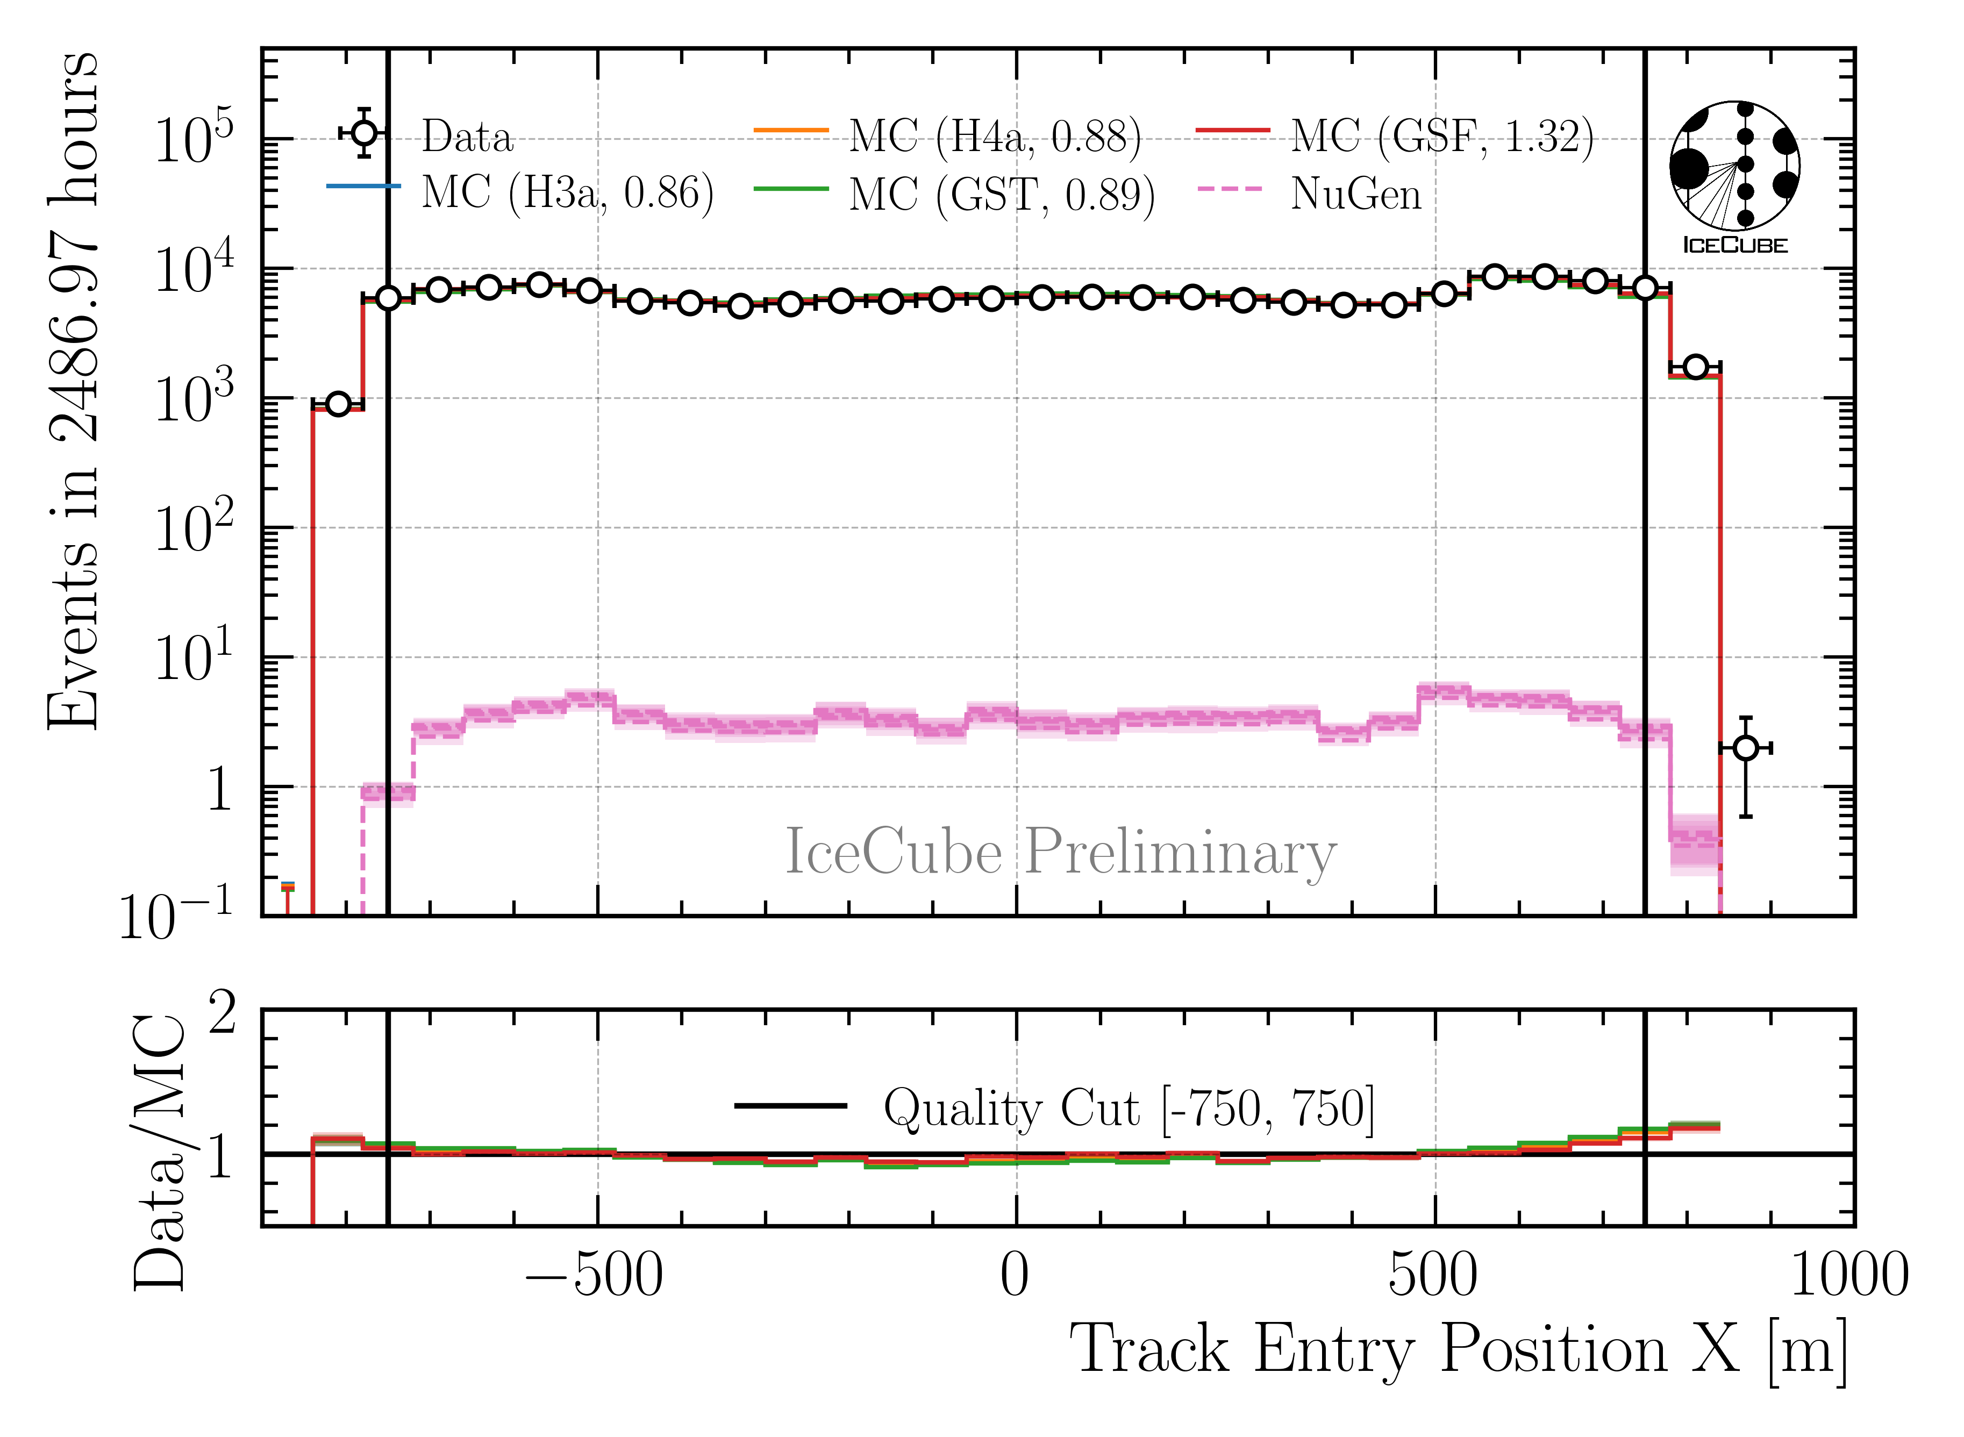
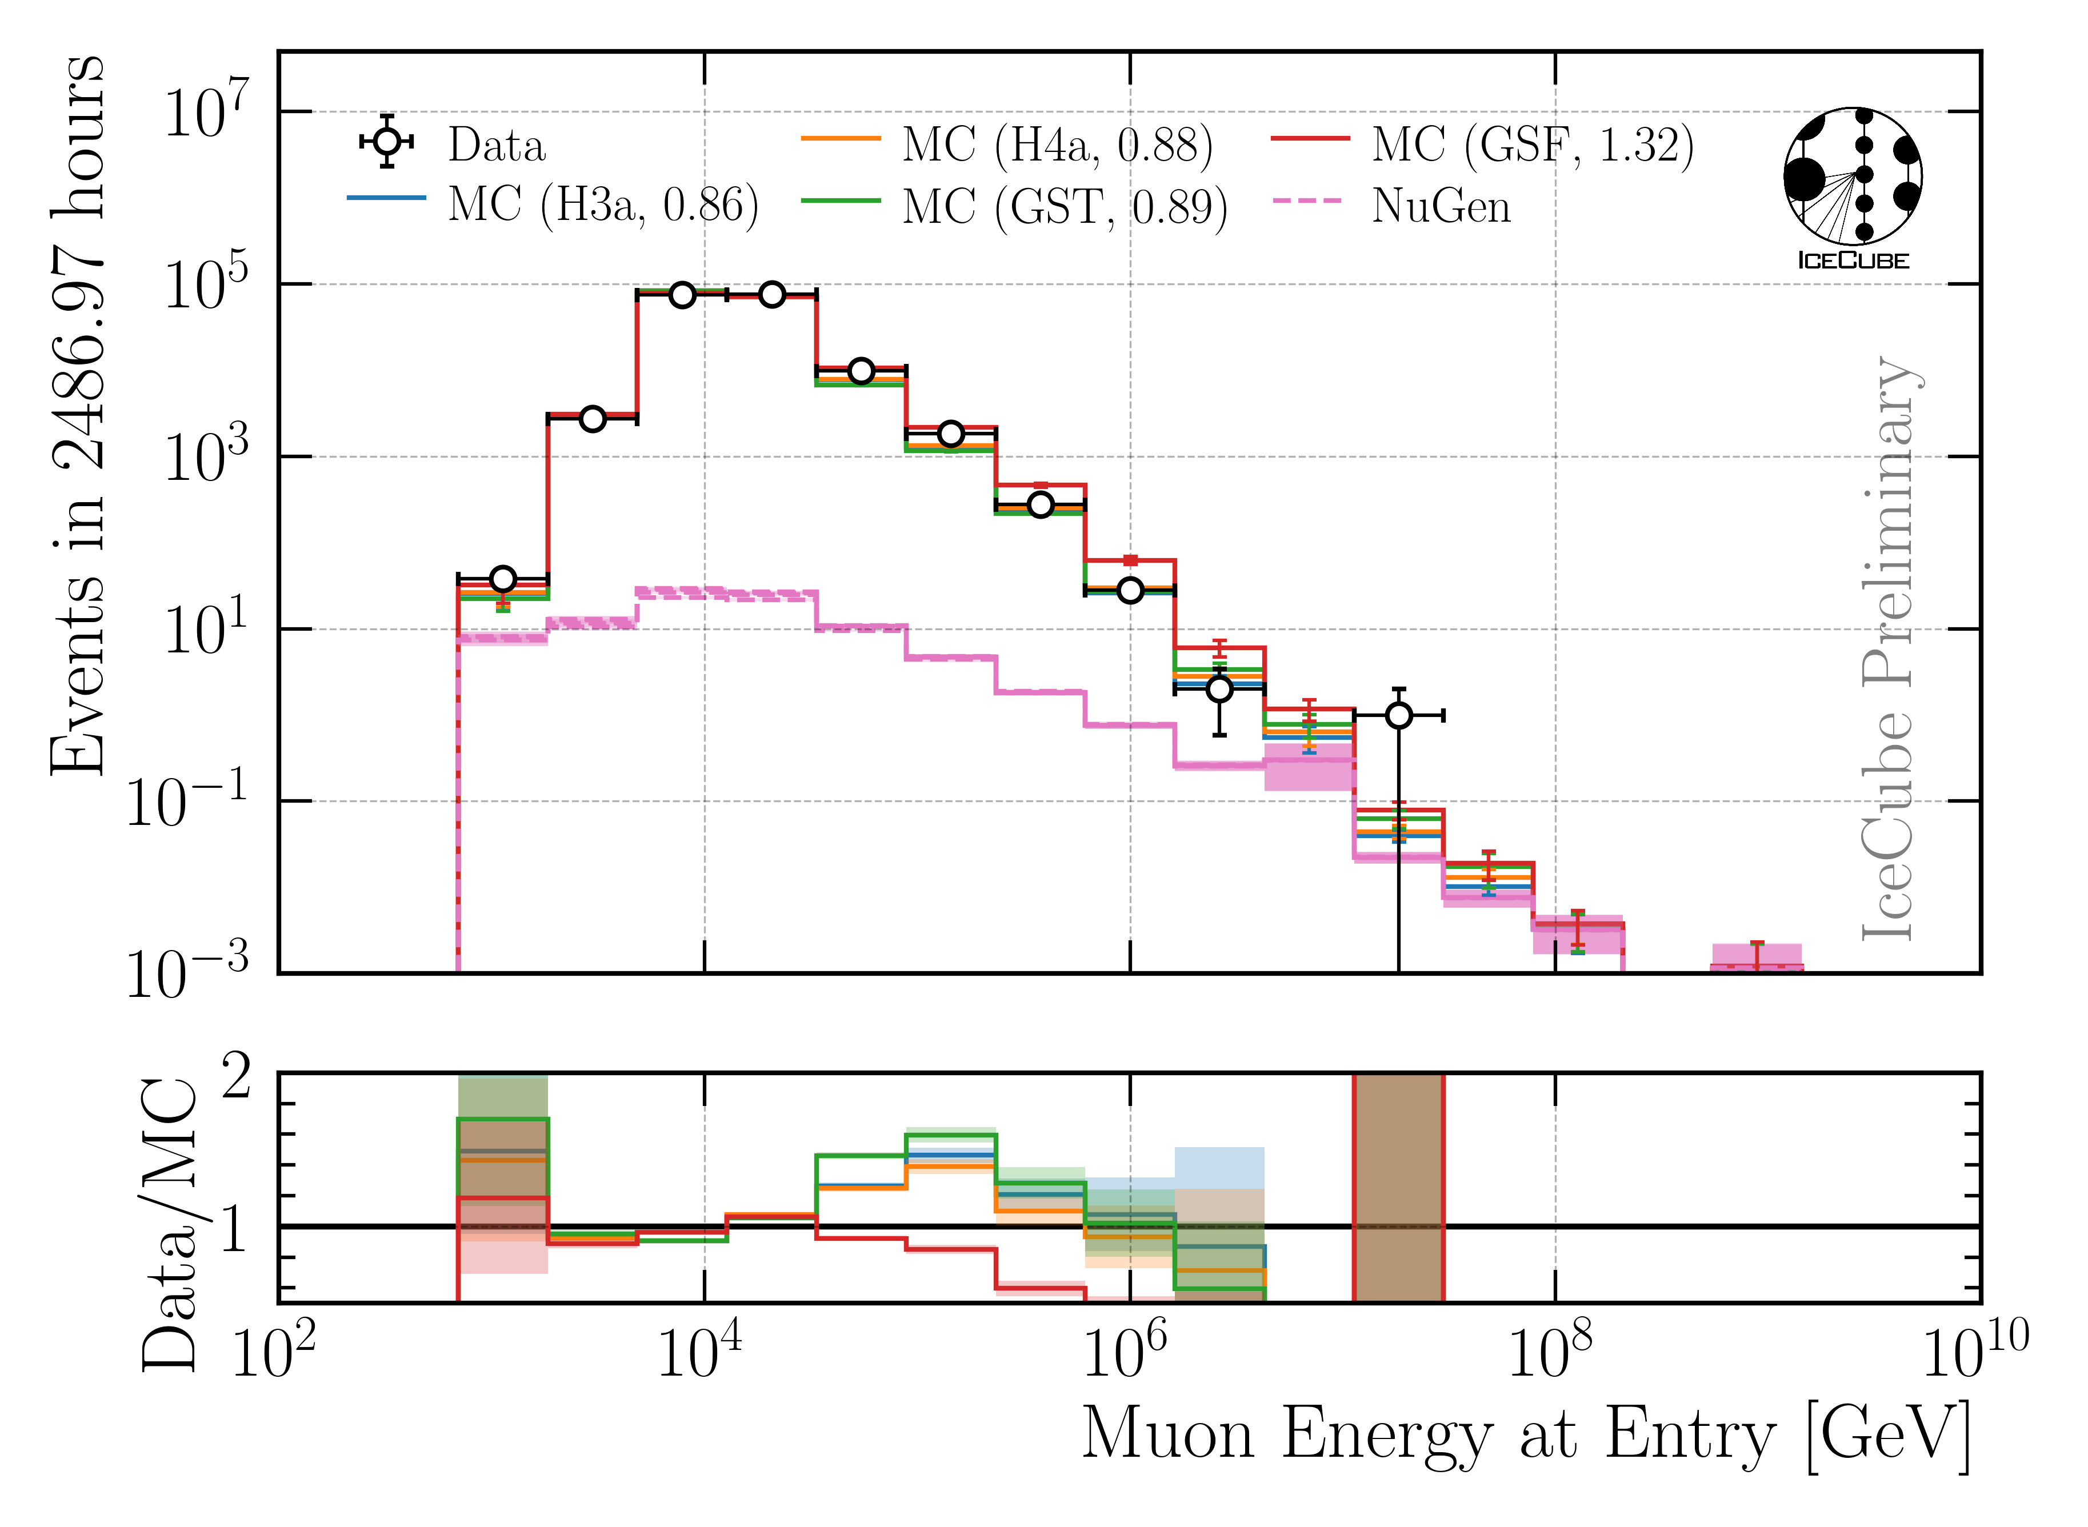
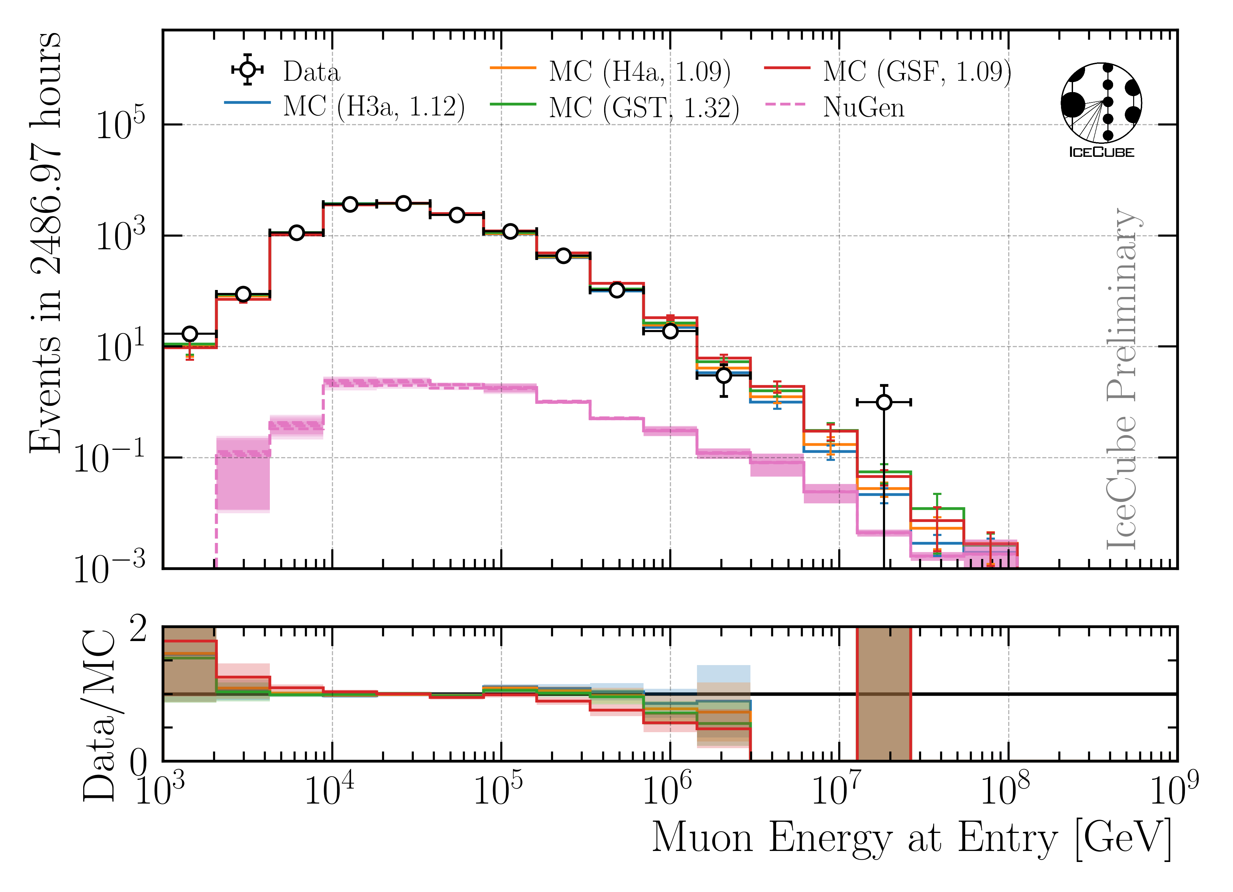
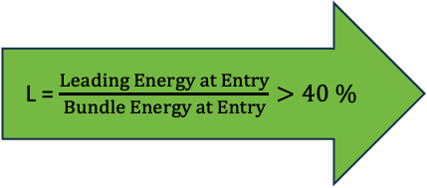
Selection
Details: wiki/selection
Level 3: MuonFilter
Level 4: E > 500 TeV bundle Energy a surface
Level 5: 23 Data/MC Quality Cuts
Final Level: L > 40 %
L = $\frac{Leading Energy at Entry}{Bundle Energy at Entry}>40 \%$
*numbers in brackets mark a scaling factor
to match the total number of data events

Slide 28
Unfolding

Slide 29
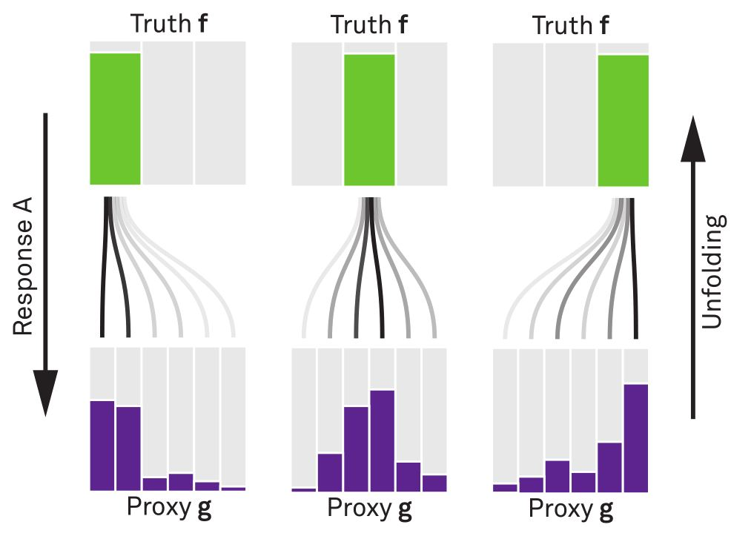


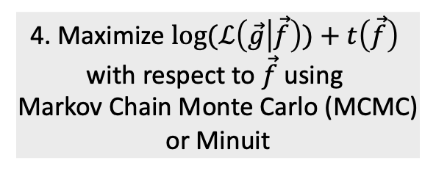
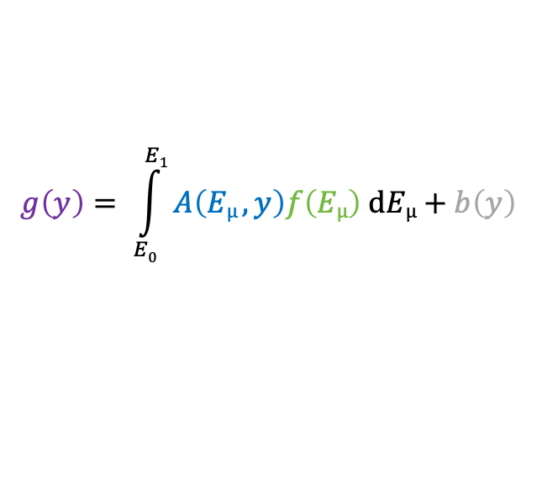
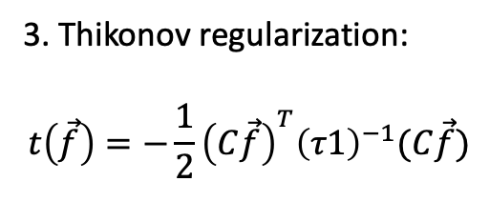
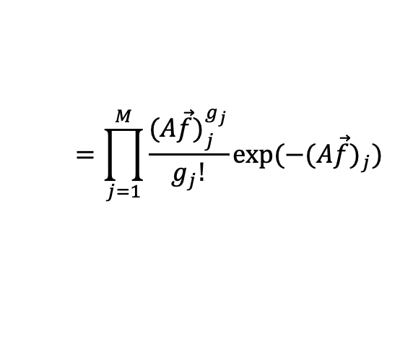
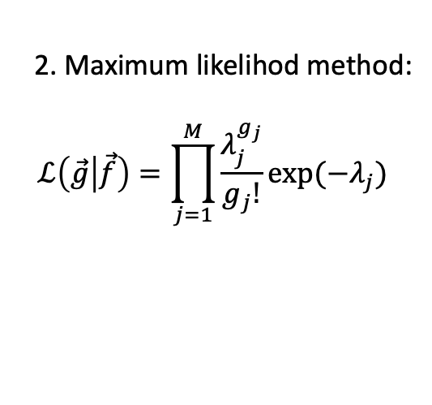
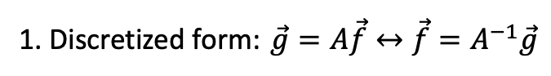
Unfolding in a nutshell
folding
unfolding
detector response
1. Discretized form: $\vec{g}=A\vec{f}↔\vec{f}=A^{−1}\vec{g}$
measured proxy
background
$$g\left(y\right)= \int_{E0}^{E1}{A\left(Eµ , y\right)f\left(Eµ\right) dEµ+b\left(y\right) }$$
2. Maximum likelihod method:
$$ℒ\left(\vec{g} | \vec{f}\right)=\prod_{j=1}^{M}{\frac{λ_{j}^{g_{j}}}{g_{j}!}exp⁡(−λ_{j})}$$
3. Thikonov regularization:
$$t\left(\vec{f}\right)=−\frac{1}{2}{\left(C\vec{f}\right)}^{T}{\left(τ1\right)}^{−1}(C\vec{f})$$
true energy distribution
$$=\prod_{j=1}^{M}{\frac{{(A\vec{f})}_{j}^{g_{j}}}{g_{j}!}exp⁡(−{(A\vec{f})}_{j})}$$
funfolding
by M. Börner
4. Maximize $log⁡(ℒ\left(\vec{g} | \vec{f}\right))+t\left(\vec{f}\right)$
with respect to $\vec{f}$ using
Markov Chain Monte Carlo (MCMC)
or Minuit
Credit: T. Hoinka

Slide 30


SnowStrom In-Ice Systematics
Parameterize impact of systematic for each proxy bin (leading muon at entry)
5 systematics x 20 bins = 100 fits
Many bins have large uncertainties → set to constant
Mainly impacted by Absorption and DOM efficiency
Included as nuisance parameters in the unfolding

Slide 31






Event Rate to Flux → Effective Area
$$A_{sim}$$
Unfolding estimates an event rate
Transfer event rate to flux
with solid angle
and effective area
$$φ_{i}= \frac{N_{i}}{T ∆E_{i} Ω_{i} A_{eff,i}}$$
$$Ω_{i}=2π (\cos\left(Ω_{min,i} \right)−{cos⁡({Ω}}_{max,i}))$$
final level events
$$A_{eff}=A_{sim}\frac{N_{sel}}{N_{gen}}$$
generation level events

Slide 32





Regularization
Find regularization 𝜏 with minimal bin-to-bin correlation
LLH minimization (unfolding) provides full covariance matrix V
Minimize global correlation
Fits are only accepted, when minuit minimization is valid
Sometimes fits fail
Fit polynomial from ${10}^{−3}−{10}^{−2}$ to determine minimum
$$ρ=\sum{V_{ij}}$$
$$i>j$$
impact of tau variation < 10 %
→ negligible in comparison to statistical uncertainty

Slide 33
“Method Bias”

Slide 34
Uncertainties: “Unfolding Bias”
Train unfolding on H3a, H4a, GSF, GST
Unfold 4 MC weighted datasets for the 4 primary models
Divide each unfolding by its true MC distribution
16 unfoldings in total
Ratio of 1 expected
Offset to 1 → bias
Maximum distance to true distribution
Add these biases as an uncertainty to the unfolding result

Slide 35





Include Uncertainties
$$σ_{tot}= \sqrt{σ_{minuit}^{2}}+ σ_{unf−bias}^{2}+ σ_{A_{eff},stat }^{2}$$
All test unfoldings agree with the truth within the uncertainties

Slide 36


Nominal / Best Fit → Average of 4 Unfoldings
Unfold H3a test dataset with all 4 primary models
Build average
$σ_{tot}= \sqrt{σ_{unf}^{2}}+ σ_{spread}^{2}$
with
$σ_{unf}= \frac{√∑σ_{tot, j}^{2}}{N}$
$σ_{spread}=std(f_{i})$
total uncertainty of the 4 unfoldings

Slide 37
Sensitive to Prompt?

Slide 38


Prediction: 12 Years of IceCube Data Unfolding
Pseudo Sample has prompt
Pseudo Sample has NO prompt
MC only
MC only
Ratio to conv
Ratio to conv
Ratio to total
Unfolding is sensitive to the prompt component
*with systematic uncertainties from effective area

Slide 39
Flux Characterization

Slide 40


Chi2 Likelihood Fit
theory model
Fit normalizations
$μ_{i}\left(N_{prompt}, N_{conv}\right)=N_{prompt}{ × f}_{prompt,i}+N_{conv} × f_{conv,i}$
$r_{i}=m_{i}−μ_{i}$
$χ^{2}=r^{T}C^{−1}r$
$C=C_{minuit}+diag\left(σ_{unf_bias}^{2}\right)+diag(σ_{A_{eff},stat }^{2})$
minimize with scipy minimize → $N_{prompt}, N_{conv}$
Significance test for prompt
$H_{0}:N_{prompt}=0, { H}_{1}:N_{prompt}, N_{conv}$free
$χ_{0}^{2}=χ^{2}(N_{prompt}=0,N_{conv})$
$χ_{1}^{2}=χ^{2}(N_{prompt},N_{conv})$
$TS={∆χ^{2}=χ}_{0}^{2}−χ_{1}^{2}$
$p= \sqrt{2} erfc \left(\sqrt{\frac{TS}{2}}\right)$
$Z= \sqrt{TS}$

Slide 41
Burnsample Unfolding

Slide 42

Burnsample Unfolding
Leading muons
2487 h IceCube data
12754 events
Agrees with MCEq
Stopping muons
47 min IceCube data
32943 events
Below MCEq prediction
ICRC PoS 281
*Stopping muon analysis done by Lucas Witthaus

Slide 43
Unblinding Plan

Slide 44
Unblinding Proposal
Unblinding plans
Unfold 12 years of data for IC86 from 2011 to 2022
Determine regularization strength on data
Perform unfolding on data
Build matrix on all 4 primary models
Fit prompt/conv normalization (significance) on all 4 unfoldings each
Build average of all 4 unfoldings → nominal values
Post-unblinding checks
Check the data-MC agreement for proxy variable (leading energy)
Pre-fit (on the entire Snowstorm dataset)
Post-fit (re-weight to fitted systematics)
Divide total dataset in 3 subsets á 4 years to analyze systematic impacts over the years
Divide dataset into 4 seasons
Paper Proposal
Present status of forward folding in November
If results look promising → cross—checks can be done until end of January next year
Combined forward and unfolding paper: Discovery of prompt?
Elif, forward folding needs much more work
Unfolding paper: Measurement of muon flux
Thank you for your attention!

Slide 45


CORSIKA 7 vs. MCEq
MCEq: tool to numerically solve the cascade equations that describes the evolution of particle densities as they propagate through a gaseous, dense medium
https://github.com/mceq-project/MCEq
Good agreement for inclusive flux
Python package developed – PANAMA
Execute CORSIKA 7 (multi core)
Read DAT files → pandas DataFrames
Parse EHIST option
Calculate primary weightings
https://github.com/The-Ludwig/PANAMA
Neste & Gutjahr et al., EPJ C, 85, 759 (2025)

Slide 46



12 Years Prediction
unfolding bias taken from all permutations
symmetric errors
asymmetric errors
$$σ_{tot}= \sqrt{σ_{minuit}^{2}}+ σ_{unf−bias}^{2}+ σ_{A_{eff},stat }^{2}$$

Slide 47


MC Statistics on Final Level

Slide 48


Input data per DOM
10.1088/1748-0221/16/07/P07041
3 inputs
c_{total}: Total charge
Sum of charge
t_{first}: Relative time of first pulse
Relative to total time offset, calculated as the charge weighted mean time of all pulses
t_{std}: Standard deviation of first pulse
Charge weighted standard deviation of pulse times relative to total time offset
9 inputs
t_{last}: Relative time of last pulse
Relative to total time offset, calculated as the charge weighted mean time of all pulses
t_{20%}: Relative time of 20% charge
Relative to total time offset, calculated as the charge weighted mean time of all pulses
t_{50%}: Relative time of 50% charge
Relative to total time offset, calculated as the charge weighted mean time of all pulses
t_{mean}: Mean time
Charge weighted mean time of all pulses relative to total time offset
c_{500ns}: Charge at 500ns
Sum of charge after 500ns
c_{100ns}: Charge at 100ns
Sum of charge after 100ns
Input pulse cleaning
6000 ns
Training data
Different simulations for robustness
Credit: IceCube

Slide 49
Reconstructed properties
Energy
entry_energy: Leading muon energy at the detector entry
bundle_energy_at_entry: Muon bundle energy at the detector entry
muon_energy_first_mctree: Leading muon energy at surface
bundle_energy_in_mctree: Muon bundle energy at surface
Track geometry
Length: Propagation length of muon in the ice
LengthInDetector: Propagation length of muon in the detector
center_pos_x: Closest x position of muon to center of the detector
center_pos_y: Closest y position of muon to center of the detector
center_pos_z: Closest z position of muon to center of the detector
center_pos_t: Time of closest approach to the center of the detector
entry_pos_x: x position of muon at the detector entry
entry_pos_y: y position of muon at the detector entry
entry_pos_z: z position of muon at the detector entry
entry_pos_t: Time of muon at the detector entry
Direction
zenith: Zenith angle of muon
azimuth: Azimuth angle of muon
Network 1
Network 0: Muon bundle energy at surface (fast pre-cut)
Network 2
Network 3

Slide 50


Energy Reconstructions
performed on Level 3 (explained later)
Sufficient energy reconstructions
Tight 68 % intervals, with outliers

Slide 51

Level 3: Muon Filter
Muon filter: zenith-dependent charge and quality cut
Choose muon filter to select as many high-energy muons as possible

Slide 52

Level 4: Energy Cut
6 billion events expected in 10 years → computationally not feasible
focus on high-energetic events
Remove low-energy muons: bundle energy at surface > 500 TeV

Slide 53


Level 5: Data/MC Quality Cuts
Neutrino weighting:
SPL: n = 1.8, 𝛾 = 2.52
IceCube Collaboration PoS ICRC2023 1064
Good directional reconstruction
Cut: cos(zenith) > 0.2

Slide 54




Level 5: Data/MC Quality Cuts
Remove outliers
Depth—dependent slope (no analysis relevance)
CR—model impact on energy reconstruction
23 quality cuts in total

Slide 55


Final Level: Leadingness > 40 %
L = $\frac{Leading Energy at Entry}{Bundle Energy at Entry}$
No leadingness cut
Leadingness > 40 %
Improve Data/MC by leadingness cut

Slide 56
Level5: quality cuts
containment cuts | > | <
length in detector | 1000 m | 2000 m
entry pos x, y | -750 m | 750 m
entry pos z | -500 m | 750 m
center pos x, y | -550 m | 550 m
center pos z | -650 m | 650 m
uncertainty cuts | <
bundle energy at entry | 0.9 log10(GeV)
bundle energy at surface | 2.0 log10(GeV)
zenith | 0.1 rad
azimuth | 0.2 rad
entry pos x , y, z | 42 m
center pos x, y, z | 50 m
entry pos time | 200 ns
center pos time | 600 ns
length in detector | 160 m
length | 2000 m
neutrino cuts | > | <
cos(zenith) | 0.2
length | 5000 m | 15000 m

Slide 57
Uncertainties per Bin

Slide 58






H3a Unfolding Bias
Fit $τ {∈10}^{−3}−{10}^{−2}$

Slide 59





H4a Unfolding Bias
Fit $τ {∈10}^{−3}−{10}^{−2}$

Slide 60





GST Unfolding Bias
Fit $τ {∈10}^{−3}−{10}^{−2}$

Slide 61





GSF Unfolding Bias
Fit $τ {∈10}^{−3}−{10}^{−2}$

Slide 62





Unfolding Bias for All Models
Summary
Add these biases as an uncertainty to the unfolding result

Slide 63


12 Years Prediction
unfolding bias taken from H3a because H3a matrix was used here
symmetric errors
asymmetric errors
$$σ_{tot}= \sqrt{σ_{minuit}^{2}}+ σ_{unf−bias}^{2}+ σ_{A_{eff},stat }^{2}$$

Slide 64
Data—MC Pre/Post Fit

Slide 65


Data-MC: Burnsample
Pre Fit
Post Fit
include entire Snowstorm dataset
re-weight to best fit systematics

Slide 66

Minuit output

Slide 67
Muon Flux Unfolding
Effective area
Systematics
Proxy that correlates with target
Regularization
Unfolding

Slide 68








Ice & Detector Systematics
σ_{sys,i} = max($A_{low}, A_{high}) −Abase$
$$σ_{tot}=\sqrt{σ_{stat}^{2}+\sum{σ_{i}^{2}}}, i:scat, abs, DOME, holeice p0, p1$$
Baseline: entire set
Subset: above/below center

Slide 69

Reconstruction and Data—MC: Leading Muons
Good reconstruction of leading muon energy → proxy
Good data—MC agreement
Global offset → upscale MC by 12%

Slide 70


Correlation and Robustness Test: Leading Muons
Build unfolding matrix on H3a, H4a, GST & GSF
Unfold H3a as test set
Results are within uncertainties → robust
Correlation between proxy and target
Burnsample

Slide 71


Determine Regularization
Find regularization 𝜏 with minimal bin-to-bin correlation
LLH minimization (unfolding) provides full covariance matrix V
Minimize global correlation
$$ρ=\sum{V_{ij}}$$
$$i>j$$
Unfold MC truth → ratio should be 1
Burnsample

Slide 72

Burnsample Unfolding
Leading muons
2487 h IceCube data
12754 events
Agrees with MCEq

Slide 73

Determine Regularization
Find regularization 𝜏 with minimal bin-to-bin correlation
LLH minimization (unfolding) provides full covariance matrix V
Minimize global correlation
$$ρ=\sum{V_{ij}}$$
$$i>j$$
Unfold MC truth → ratio should be 1
Burnsample

Slide 74


Bundle Energy Reconstruction
Level 4
Level 5
IceCube Preliminary
IceCube Preliminary

Slide 75

Cosmic ray flux
Arxiv: 1903.07713
Notes:
1. Knee: ~3 PeV, before gamma = 2.7, limit of acceleration mechanism for cosmic rays in supernova remnants 2. Knee: ~100 PeV, before gamma = 3.1, heavier elements, like iron, from galactic sources start to reach their maximum acceleration energy → more protons, larger energy in electromagnetic acceleration Ankle: ~1 EeV, flattens out again, transition point between galactic and extra galactic particle origin,

Slide 76



Air shower – 10 TeV
Ralph Engel 2005
“muon bundles”
2211.16970v2
Proton
www.iap.kit.edu/corsika
Iron
Notes:
shower maximum: x_max, slant depth at which the number of particles is the greatest, more energetic and lighter cosmic rays produce deeper/lower x_max, while heavier nuclei have a higher shower maximum
measure number of particles / muons
lateral spread
nitrogen can be excited → fluorescence light emitted
iron produces more muons than proton, because it has 56 nucleons → higher fragmentation → “sub-showers”

Slide 77

Prompt atmospheric muons and neutrinos
10.1103/PhysRevD.100.103018
no unflavored
dominated by pions
dominated by kaons
Combined fit:
handle on pion/kaon ratio
handle on charmed mesons

Slide 78
CORSIKA 7 tagging and MCEq comparison
MCEq: tool to numerically solve the cascade equations that describes the evolution of particle densities as they propagate through a gaseous, dense medium
https://github.com/mceq-project/MCEq
GSF weighting
GSF weighting
Good agreement in total prompt and conv muon flux
D⁰ and D_{s} are swapped here but this is fixed in MCEq
mention panama

Slide 79

Final Level cos(zenith)

Slide 80


MCEq vs CORSIKA

Slide 81
Coincident Events with 22615

Slide 82


Muon Energy at Surface
simulated
weighted
Leading Muon: most energetic muon in tree
Bundle Energy Signal: sum of all muons of ”signal” primary
Bundle Energy Background: sum of all muons of coincident primaries

Slide 83


Coincidence: Muons on Event Level
100% Signal
50% Signal, 50% Background
100% Background
above 10 TeV, no background dominated events

Slide 84
Estimate Rates with H3a
Signal rate: 0.84 mHz (total event rate)
Background rate: 0.68 mHz (event rate with at least 1 coincident primary)
Signal rate: 0.74 mHz (leading muon energy at surface > 10 TeV)
Background rate: 0.58 mHz (event rate with at least 1 coincident primary & lead. muon E. > 10 TeV)
Signal rate: 0.74 mHz (leading muon energy at surface > 10 TeV)
Background rate: 0.02 mHz (event rate with at least 1 coincident primary & lead. muon E. > 10 TeV & coincident muon bundle energy at surface hast at least 10% of leading muon energy)
The light of the background events overlaps with the signal → no chance to separate
A 10% bundle energy contribution would shift the measured light up by roughly 10% → within the uncertainties of the energy prediction
Networks have been trained on MC with coincident events → they are able to subtract a little light in case they assume there is a background event, however, this is not quantified

Slide 85





Reconstructions: Coincident Events
no background event
$\frac{\text{bundle} \text{energy} \text{at} \text{surface}}{\text{leading} \text{energy} \text{at} \text{surface}}$ < 0.1
$\frac{\text{bundle} \text{energy} \text{at} \text{surface}}{\text{leading} \text{energy} \text{at} \text{surface}}$ > 0.1
sufficient energy reconstruction for events with background

Slide 86
Coincident Events with 20904

Slide 87


True MC Distributions

Slide 88


Coincidence: Muons on Event Level
100% Signal
50% Signal, 50% Background
100% Background
above 10 TeV, no background dominated events

Slide 89
Estimate Rates with H3a
Signal rate: 1.31 mHz (total event rate)
Background rate: 0.20 mHz (event rate with at least 1 coincident primary)
Signal rate: 1.24 mHz (leading muon energy at surface > 10 TeV)
Background rate: 0.13 mHz (event rate with at least 1 coincident primary & lead. muon E. > 10 TeV)
Signal rate: 1.242 mHz (leading muon energy at surface > 10 TeV)
Background rate: 0.001 mHz (event rate with at least 1 coincident primary & lead. muon E. > 10 TeV & coincident muon bundle energy at surface hast at least 10% of leading muon energy)
The light of the background events overlaps with the signal → no chance to separate
A 10% bundle energy contribution would shift the measured light up by roughly 10% → within the uncertainties of the energy prediction
Networks have been trained on MC with coincident events → they are able to subtract a little light in case they assume there is a background event, however, this is not quantified

Slide 90




Reconstructions: Coincident Events
$\frac{\text{bundle} \text{energy} \text{at} \text{surface}}{\text{leading} \text{energy} \text{at} \text{surface}}$ > 0.1
no background event
$\frac{\text{bundle} \text{energy} \text{at} \text{surface}}{\text{leading} \text{energy} \text{at} \text{surface}}$ < 0.1
leading energy at surface > 10 TeV
20904
sufficient energy reconstruction for events with background

Slide 91
Estimate Impact of Hadronic Interaction Model
Different CR Models
Different Haronic Models
Not all hadronic models include charm
Impact of HIM smaller than CRM
Hadronic Model impact is negligible

Slide 92


Reconstruction: EPOS-LHC vs SIBYLL 2.3d [Level 5]
EPOS-LHC
SIBYLL 2.3d
IceTop simulations for proton and iron
23198 and 23201
Primary energy > 1e7

